Slide 1
PROJECT CHANGES
Implementation Seminar

Slide 2
Content
Classification of changes
Minor changes
Major changes
Procedure

Slide 3
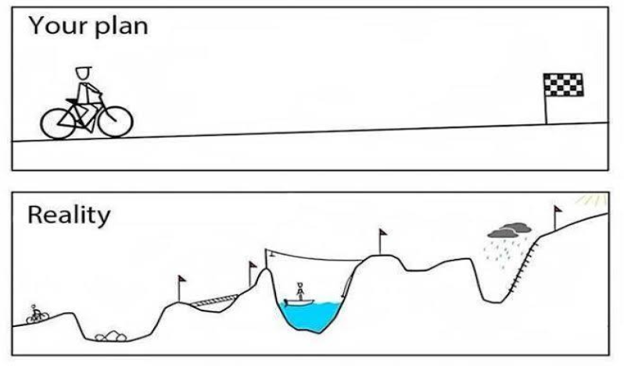
Nothing goes as planned, but that is fine provided someone controls the situation

Slide 4
CLASSIFICATION
By focus:
Changes in the LP&PP information
Changes in the project partnership
Changes in the work plan
Changes in the budget
Changes in the duration

Slide 5
CLASSIFICATION
By type:
Minor changes (no prior approval but mandatory consultation with JS)
Major changes (prior approval)

Slide 6
MINOR CHANGES
Must be reported via progress reports
Changes in the LP&PP information
Contact data | Update information immediately via eMS
Bank account | Update information immediately via eMS
VAT payer status | Submit updated application form via eMS Submit updated partner declaration via eMS

Slide 7
MINOR CHANGES
Changes in the work plan
Must be reported via progress reports
Minor adjustments in the workplan | Communicate minor changes to the JS via progress reports
Minor adjustments in informative publications
Changes in the budget
Changes in costs within one BL | Communicate minor changes to the JS via progress reports
Changes in BL1 for Real Costs method

Slide 8
MAJOR CHANGES
Changes in the project partnership
Withdrawal of PP without replacement
Replacement of PP with existing PP
Replacement of PP with new PP
Structural / legal changes of PP
Restrictions

Slide 9
MAJOR CHANGES
Changes in the budget
Reallocation between BLs and/or PP (up to 30% of total budget)
Reallocation between items under BL1 for Real Costs method
Restrictions

Slide 10
MAJOR CHANGES
Changes in the project activities
Increase/decrease in the amount of existing project outputs and/or results
Extend/reduce the range of the existing project activity
Create new project output and/or activity
Hand over activity to other project partner
Restrictions

Slide 11
MAJOR CHANGES
Changes in the duration
Prolongation of project duration:
project implementation not longer than 31.12.2020
Changes of reporting periods:
from 3 to 6 months or vice versa
merging of reporting periods
Restrictions

Slide 12
Request for change via eMS
Assessment by JS and clarification
Approval by MA/MC
Update of information and documentation in eMS
Addendum to Subsidy contract & Partnership Agreement (if applicable)
PROCEDURE

