Slide 1


COMMUNICATION IN THE PROJECT
Implementation Seminar

Slide 2
Five musts of project communication
2. Make photos and videos
4. Inform JS about events two weeks in advance
5. Always check if your meet the project communication requirements
3. Keep evidences
1. Use the Programme logo and acknowledge EU support

Slide 3
Communication stratetgy
Already defined in the project application
Aim of communication
Message of project
Target group
Communication activities
Communication tools

Slide 4

Telling story of your project
Message of your project
prepare 3–5 main messages
state main objectives and expected results
explain what you are doing and why
messages are not slogans or advertising texts
translate title of your project
  Use plain language, be simple

Slide 5
Visibility rules
The main principles of the publicity requirements to the projects
Displaying logo of the Programme
Informing about the project
Providing information on the financial funding of the European Union and the Programme
Using a disclaimer that the EU is not responsible for the provided information.

Slide 6


Communication guidelines
Requirements for different communication activities
Dictionary of main terms and phrases
(EN-LV-LT)
Guide on use of logo
Guide how to manage project section on the Programme website
Template of plaque and poster
Use it as check-list!

Slide 7
Mandatory elements of project communication
Informative posters at premises of each project partner
Information on websites of each project partner
Information in special section of the Programme website
At least two press releases
Marking of infrastructure objects
Marking of equipment
Requirements for the communication activities are in detail described in PM and Communication guidelines

Slide 8
Programme logo
Available language versions
  Mixed
  Latvian
  Lithuanian

Slide 9
Programme logo
Other logos can not be larger than EU emblem
The minimum withdraw of the programme logo is 60 mm

Slide 10
Websites an social media
Mandatory: information about the project on websites of each of project partners.
No
scrolling down
to see the Programme logo!
#LATLIT
Use of social media is encouraged
Use plain language

Slide 11
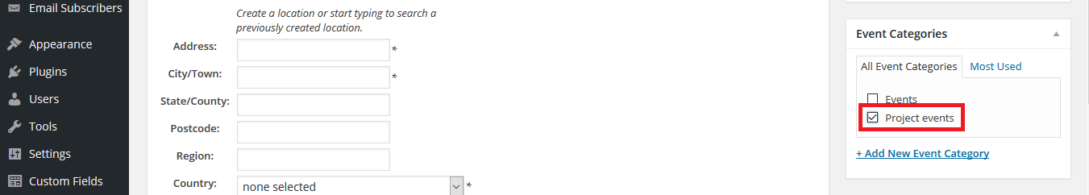
Project information on Programme website
Send request for the user name to Janis.Vanags@varam.gov.lv
Partner information should be added: http://latlit.eu/partner-search/
Enter information about your project
Enter information into calendar not latter than 2 weeks prior event
Use photos and videos

Slide 12


Informative posters
Mandatory: at least A3 size informative posters at premises of each project partner.
Project title should be in the colour of the Programme priority
Use plain language to explain aim of the project and other information

Slide 13




Colours of the Programme Priorities
Sustainable and clean environment
Labour mobility and employment
Social inclusion
Efficient public services

Slide 14

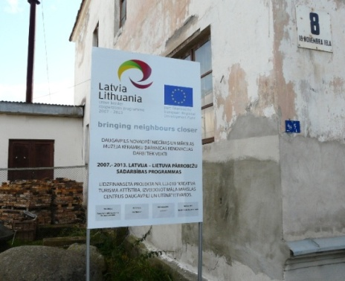
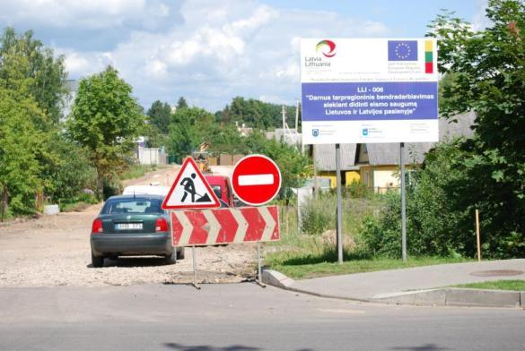
Marking of infrastructure objects
Mandatory for project with infrastructure works exceeding 500 000 EUR:
temporary billboard of significant size.
permanent plaque or a billboard in three months after the completion of (re)construction.
  At least 5 years after the finalization of the project.

Slide 15
Articles, press releases and other information
Mandatory: at least two press releases
Hints
If reported as deliverable must contain:
Programme logo
Project title
A disclaimer
Information about financial support of the Programme.
Address of a website where more information is available
Copies of all press releases and articles must be sent to JS.
The most interesting and important information first.
Should fit into one A4 page.
Contacts for more information.
Press release text in e-mail body and in attached file.
Attach a couple of photos and/or link to video.

Slide 16
Labeling of equipment
Mandatory: labeling of equipment and purchases
Put stickers with the Programme logo.
Put plaque in premises if items are not movable.
  At least 5 years after the finalization of the project.

Slide 17
Events
All event materials must contain
1) programme logo, and
2) project title.
- use Programme template for list of participants
The EU flag and/or movable stands of the projects, containing the Programme logo have to be displayed at all events
Programme logo has to be placed in a clearly visible place
- photos showing placement of the logo must be provided with report
Not latter than two weeks before event:
- enter event in the calendar on the Programme website
- inform JS via eMS
Save for reporting lists of participants, photos and all related materials

Slide 18
Penalties
Type of mistake | Amount of correction
Publicity requirements have not been fulfilled, but the publicity elements can be added | 0-10% or warning
Technical mistakes related to publicity requirements (mistakes with colours, size or similar) | 10%
Elements of the publicity requirements missing | 25%
No publicity requirements have been fulfilled, and no corrective measures are possible | 100%

Slide 19
Practical task: rool-up banner

