Slide 1
PROJECT CHANGES

Slide 2
Content
Classification of changes
Minor changes
Major changes
Procedure

Slide 3
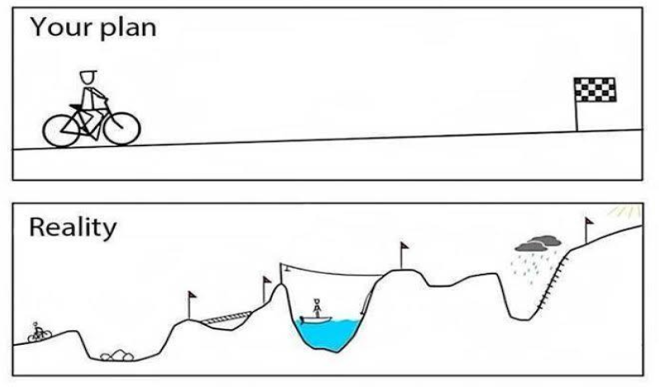
Nothing goes as planned, but that is fine provided someone controls the situation
General rule – activities shall be implemented according to Application Form
In case of deviation
Apply change procedure

Slide 4
CLASSIFICATION
By focus:
Changes in the LP&PP information
Changes in the project partnership
Changes in the work plan
Changes in the budget
Changes in the duration
Changes in the reporting

Slide 5
CLASSIFICATION
By type:
Minor changes (some require approval of JS)
Major changes (prior approval of MA/MC)

Slide 6
MINOR CHANGES
Changes in the LP&PP information
 | PM Version No 2 (approved on April 4, 2017) | PM Version No 3 (approved on August 7, 2017)
Contact data | Update information immediately via eMS | Update information immediately via eMS and communicate changes via progress report
Bank account | Update information immediately via eMS | Update information immediately via eMS

Slide 7
MINOR CHANGES
Changes in the work plan
 | PM Version No 2 (approved on April 4, 2017) | PM Version No 3 (approved on August 7, 2017)
Rescheduling project activities | Communicate via progress reports* | Communicate via progress reports
Minor adjustments in number of informative publications | Communicate via progress reports* | Request minor change in eMS Approval of JS Update in application form
Minor changes in project activities | n/a | Request minor change in eMS Approval of JS Update in application form
* Prior consultation with JS was required

Slide 8
MINOR CHANGES
Changes in the budget
 | PM Version No 2 (approved on April 4, 2017) | PM Version No 3 (approved on August 7, 2017)
Changes in costs within one BL | Communicate via progress reports* | Communicate via progress reports
Changes in BL1 for Real Costs method (within one cost item) (between planned items – PM Version 3) | Communicate via progress reports* | Communicate via progress reports
Changes in BL1 for Real Costs method (number of employees, creating, merging sub-budget lines) | n/a | Request minor change in eMS Approval of JS Update in application form
* Prior consultation with JS was required

Slide 9
EXAMPLE OF CHANGES IN BUDGET
 | BL 4 1200 | BL5 1500 EUR
Planed in AF | LP € 400 | PP2 € 400 | PP3 € 400 | Total € 1200 | LP € 500 | PP2 € 500 | PP3 € 400 | Total € 1500
Period 1 | 500 |  |  | 500 |  | 600 |  | 600
Period 2 |  | 500 |  | 1000 | 600 |  |  | 1200
Period 3 |  |  | 200 | 1200 |  |  |  | 1200
Major changes
Period 4 |  |  |  | 1200 |  |  | 400 | 1600
Total | +100 | +100 | -200 | 1200 | +100 | +100 |  | 1600

Slide 10
MAJOR CHANGES
!!! If major changes are needed, LP must inform the JS as soon as possible during the project implementation, but not later than one month before the project end.

Slide 11
MAJOR CHANGES
Changes in the project partnership
Withdrawal of PP without replacement
Replacement of PP with existing PP
Replacement of PP with new PP
Structural / legal changes of PP
Changes are approved by MA.
MC takes decision in cases where respecting of eligibility criteria is questioned.
(before PM version 3, structural/legal change was approved by MC)

Slide 12
MAJOR CHANGES
Changes are approved by MA
Changes in the budget
Reallocation between BLs and/or PP (up to 30% of total budget)
Reallocation between items under BL1 for Real Costs method – no longer major change (approved with PM Version 3)

Slide 13
MAJOR CHANGES
Changes in the project activities
Increase/decrease in the amount of existing project outputs and/or results
Extend/reduce the range of the existing project activity
Create new project output and/or activity
Hand over activity to other project partner
Changes are approved by MA.
MC takes decision on changes which affect achievement of Programme output and result indicators, or in exceptional cases.

Slide 14
MAJOR CHANGES
Changes in the duration, reporting, VAT status
Prolongation of project duration: not more than 24 month and project implementation not longer than 31.12.2020
Changes of reporting periods: from 3 to 6 months or vice versa and merging of reporting periods, only once during project lifetime
VAT payer status changes: total project budget cannot be increased
Changes are approved by MA
MC takes decision in case of request to prolong project duration by more than six month
Changes are approved by MA

Slide 15
PROCEDURE
Request for change via eMS
Approval of MA/MC
Update of information and documentation in eMS
Addendum to Subsidy contract & Partnership Agreement (if applicable)
Minor change
Update of information and documentation in eMS
Major change
Approval of JS

Slide 16
PROJECT CHANGES IN EMS

Slide 17
OVERVIEW
The LP is responsible for preparing the request for changes on behalf of all of the project partners and its submission via the eMS to the JS. The LP must involve all partners in the discussions in due time so that the needs of the whole partnership are reflected in the request for changes.
www.latlit.eu

Slide 18
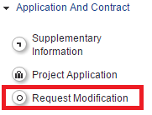
PROCEDURE
1) The LP shall press button “Request Modification” on the left side menu under section “Application and Contract”.
www.latlit.eu

Slide 19
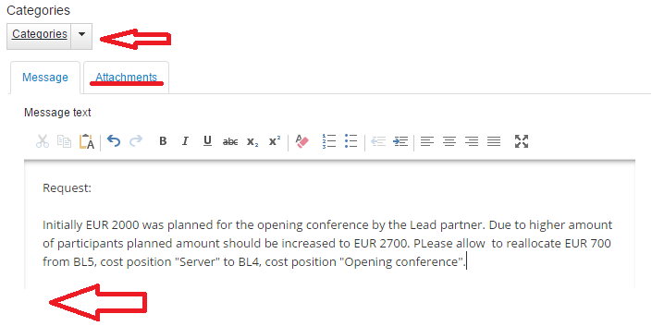
PROCEDURE
2) In the displayed form “Change request” LP shall specify categories of changes, provide description of changes (Fig.16) and attach documents in section “Attachment”, if necessary. Template of the Request for Changes is available on our website www.latlit.eu in section “How to implement”.
First, fill in provided template and harmonise changes with JS. Only after JS approval, submit modification request.
www.latlit.eu

Slide 20
PROCEDURE
The JS responsible Project manager will assess the request for changes. Clarifications can be asked from the LP and corrections of the request for changes can be requested.
When the request for changes is approved, the LP will receive message with decision and the application form will be open for modification for the LP.
LP shall update application form according to approved changes stated in the decision.
www.latlit.eu

Slide 21
PROCEDURE
!!! When implementing changes in the project budget, please update partner contribution in section “Partner budget/Define contribution”
www.latlit.eu

Slide 22
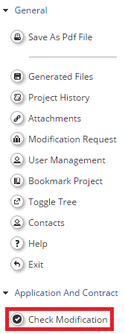
PROCEDURE
When all necessary updates are made, the LP shall check modification by pressing button “Check modification” under section “Application and Contract”
www.latlit.eu

Slide 23
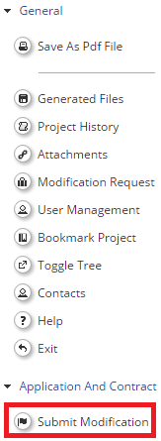
PROCEDURE
The system will ask for confirmation Yes/No. If check is successful, then notification will be displayed “Prepared to submit”. If check is successful, the updated application form can be submitted to the JS - press button “Submit modification”
When the modified application is submitted to the JS, the LP will get an automatic message to the eMS Mailbox that modification request was submitted to the JS. Project state will be changed to “Cr_done”.
www.latlit.eu

Slide 24
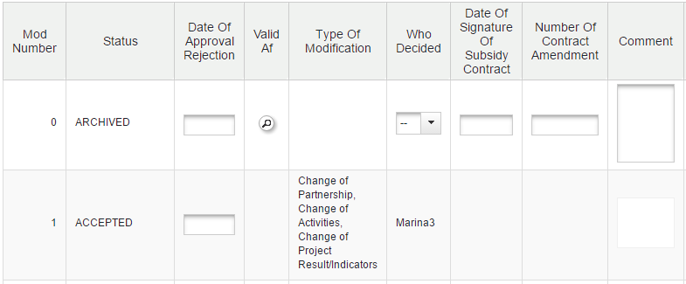
PROCEDURE
The JS responsible Project manager will check updated application form. If the modifications are done in acceptable and justified manner, according to what had been approved by the JS/MA or MC, the modified application form is approved. If something needs to be corrected or clarified the JS responsible Project manager will hand the modification back for the LP.
When the updated application form is approved a new version of the application form will be the valid one and the old version of the application form will be archived. The old and new version can be found and compared by clicking “Project history” at the left side menu
www.latlit.eu

Slide 25
PROCEDURE
After the updated application form is approved the project state will be “Contracted”, the LP will a get a message that changes in the application form are approved.
If project changes relate to content of Subsidy contract, amendments for the Subsidy contract will be prepared by the MA/JS and sent to LP for signing.
One copy of the Subsidy contract (with MA internal signatures) need to be returned back.
www.latlit.eu

Slide 26
PROCEDURE
Useful tips:
When preparing a request for change – gather all necessary changes needed from all the partners.
It is possible to combine major/minor changes in one Request for Changes. But please separate both type of changes
Check Guidance How to implement the project Part I – http://latlit.eu/how-to-implement/
Consult with JS
www.latlit.eu

Slide 27
PROCEDURE
!!! Important note:
If modification request is submitted, most functions in the eMS are not active:
Partner, progress reports cannot be filled in and submitted to FC/JS
Other modification requests cannot be submitted
Supplementary information is not active
Other functions in eMS are not active.
Plan timeline for submission of changes in eMS carefully. Avoid submission of changes close to report preparation/submission
www.latlit.eu

Slide 28
Thank you for your attention!!!
Any questions?

