Slide 1
REPORTING THROUGH THE EMS
Implementation Seminar

Slide 2
REPORTING THROUGH THE EMS
Partner report - each project partner (PP) and Lead partner (LP)
Activity reporting
Reporting expenditures
Consolidated progress report (in eMS “Project report”) - only LP
Activity reporting
Reporting expenditures

Slide 3
REPORTING THROUGH THE EMS
Before reporting check if information in section “Supplementary information” is filled in:
Project management – details on LP’s project management staff
Bank information – bank account is specified and Confirmation of financial information (template is here: http://latlit.eu/how-to-implement/) is uploaded
User assignment – LP and all PPs users are assigned
Partnership agreement - Partnership agreement is uploaded

Slide 4
REPORTING THROUGH THE EMS
Procurements above the thresholds – project partners can specify here information on contracts signed through procurements above the thresholds and to make a link to these contracts when reporting costs in “List of expenditure”

Slide 5
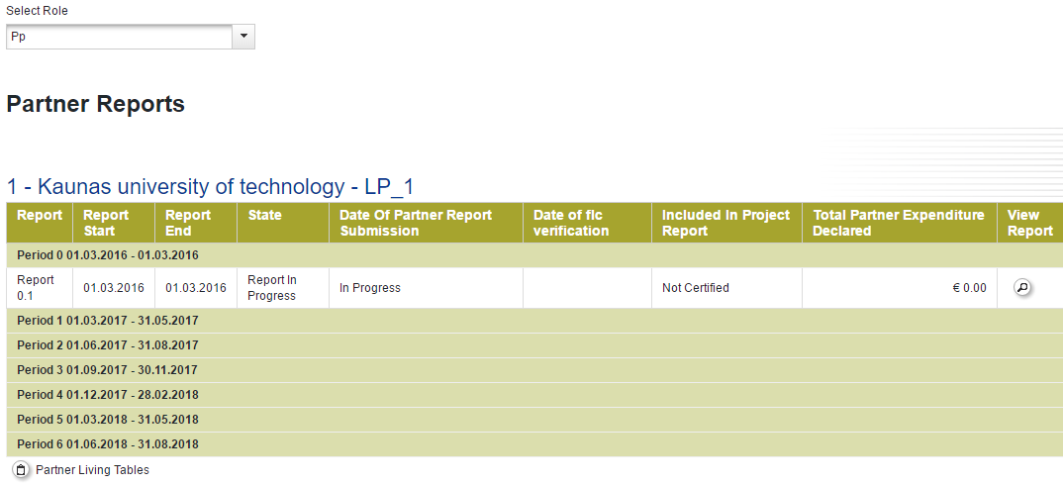
PARTNER REPORT
LP and each PP must fill in!
To create Partner report select role “PP” and choose period
Reports have to be prepared one by one: for period 0, 1, 2…

Slide 6
PARTNER REPORT
The Partner Report includes four sections:
Partner Report
List of Expenditure
Contribution and Forecast
Attachments

Slide 7
PARTNER REPORT
In section “Partner Report” describe the following:
Summary of partner work – specify activities implemented and main achievements of the project partner
Project main outputs delivered

Slide 8
PARTNER REPORT
Target groups reached

Slide 9
PARTNER REPORT
Reporting per work packages:
For each work package describe activities implemented during reporting period
Describe problems/deviations faced
Describe deliverables implemented and attach evidences of deliverables (list of participants, photos from events, equipment, result of works, etc.) (! file name shall contain topic of the document)

Slide 10
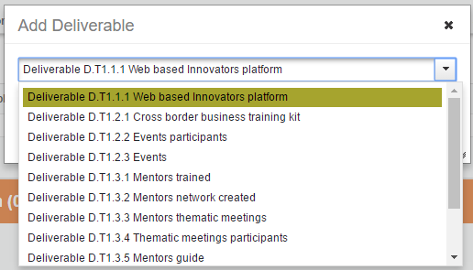
PARTNER REPORT

Slide 11
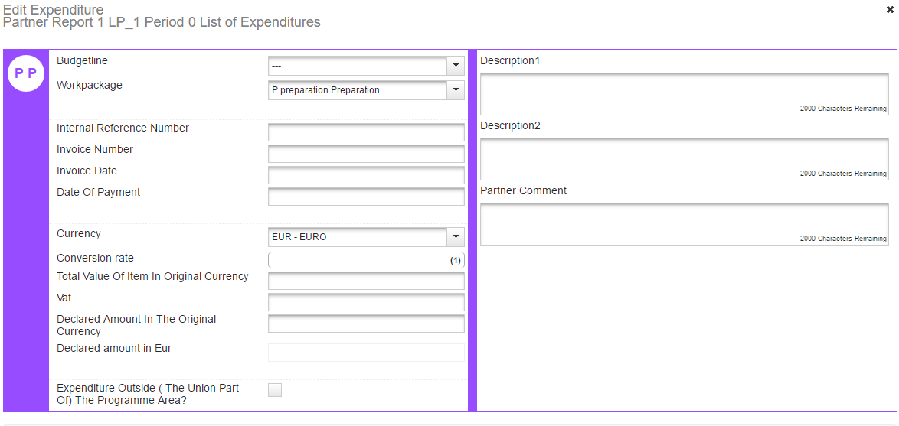
PARTNER REPORT
List of Expenditures
Add costs to “List of Expenditure” by filling in form:
Report according to costs planned in the application form

Slide 12
PARTNER REPORT
List of Expenditure
Budget Line under which costs are planned
Work package under which costs are planned
Procurement – link to contract specified in section “Procurements above tresholds/Supplementary information”
Internal reference number - transaction number in your accounting system
Invoice date
Date of payment – payment date in book-keeping system
Currency – select the currency the costs incurred in
Total value of item in original currency – total costs including VAT
VAT

Slide 13
PARTNER REPORT
List of Expenditure
Declared amount in the original currency – amount of costs declared (excluding VAT if VAT can be recovered by the project partner or with VAT if that is definitely borne by the project partner)
Expenditure outside the programme area
Description 1 – full name of service/goods provider
Description 2 – information about why costs were reported
Partner comment – more explanation, if needed

Slide 14
PARTNER REPORT
List of Expenditure
Upload - attach all supporting documents for reported costs
(e.g. in case of organisation of event – procurement documentation, service contract, payment documents, list of participants, agenda, photos from event, etc.)
Supporting documents (e.g. procurement documents, service contracts or labour contracts) for costs that are paid regularly can be submitted once with Partner report 1 and in next reports only changes should be submitted, if applicable
If invoice is for bigger amount then paid from the project, on the invoice should be specified exact reported amount.
(! file name shall contain topic of the document)

Slide 15
PARTNER REPORT
List of Expenditure
Reported costs will be displayed in the list:
Reporting of staff costs and office and administration costs using flat rate method is ensured automatically by the system:

Slide 16
PARTNER REPORT
Contribution and forecast
Estimated expenditure – how much money will be spent during next reporting period. If forecast differs from the approved spending in application form, provide brief description
Amount of partner contribution in the report – if incorrect amount or fields left unfilled, report cannot be submitted

Slide 17
PARTNER REPORT
Attachments
Upload any documents that you find relevant for the report. However, supporting documents for reported costs should be attached in section “List of Expenditure”
Submission of report
Check prepared report
Submit report to Financial control (FC)
Please inform your Financial controller that the Partner report is submitted in the eMS

Slide 18
VERIFICATION OF PARTNER REPORT
During verification of the Partner report FC may:
Revert Partner report to the project partner for correction or open section “Attachments” to upload missing documents
Deduct ineligible costs
Withdraw costs as “costs under clarification”
After Partner report is verified, FC issues certificate on approved costs and it is available in reporting section

Slide 19
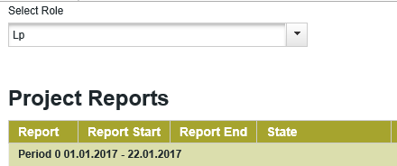
CONSOLIDATED PROGRESS REPORT
To create Consolidated progress report select role “LP” and choose period
Only Lead partner must prepare Consolidated progress report
based on partner reports!

Slide 20
CONSOLIDATED PROGRESS REPORT
The Consolidated Progress Report includes five sections:
Report
Work packages
Certificates
Project report tables
Attachments

Slide 21
CONSOLIDATED PROGRESS REPORT
Report
Highlights of main achievements – describe the progress of the project activities towards project main outputs and results
List of partners FC certificates – add FC certificates

Slide 22
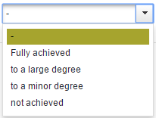
CONSOLIDATED PROGRESS REPORT
Report
Project specific objectives – select the level of achievement and provide explanation
Project main outputs achievement – automatic overview of progress reached taken from work packages

Slide 23
CONSOLIDATED PROGRESS REPORT
Report
Target groups reached – quantity, source of verification (proof that the target group was reached), short description
Problems and solutions found – explain any problems encountered during reporting period and solutions found
Fully implemented – must be ticked only for the final project report

Slide 24
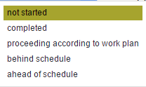
CONSOLIDATED PROGRESS REPORT
Work packages
WP status
Describe the progress in activities implemented and how partner were involved
Describe and justify any problems and deviations (including minor changes that have to be communicated via Progress reports)
Status of activities and deliverables (if not reached or delayed, provide explanation)

Slide 25
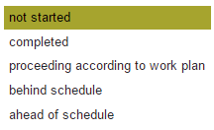
CONSOLIDATED PROGRESS REPORT
Work packages
Indicate level of achievement for project main outputs
Attach evidence of achieved project main output and deliverable if that was not provided with the Partner report (! file name shall contain topic of the document)

Slide 26
CONSOLIDATED PROGRESS REPORT
Certificates
Under “Certificates” section LP sees all costs reported by the project partners and certified by FC (List of expenditure)
LP should include all these costs in the Consolidated progress report section “Report”

Slide 27
CONSOLIDATED PROGRESS REPORT
Project report tables
Project report tables show different summary tables of the expenditure included in the Consolidated progress report.

Slide 28
CONSOLIDATED PROGRESS REPORT
Attachments
Please attach:
electronically signed confirmation letter (template is here: http://latlit.eu/how-to-implement) by the authorised representative of LP’s institution that is specified in the applicaton form. If person is different, please attach also document giving rights for signing of documents.
If electronically signed Confirmation letter is not attached, LP shall send it by post to JS.
any documents that you find relevant for the report. The file name shall contain topic of the document attached and title of the partner (e.g. LP_list_of_participants_seminar_Utena.pdf).

Slide 29
CONSOLIDATED PROGRESS REPORT
Submitting of the report
Check prepared report
Submit report to JS
Please inform JS responsible Project manager when the report is submitted.
Consolidated progress report is not verified by JS until Confirmation letter is not received at JS.

Slide 30
REPORTING PREPARATION COSTS
0 period
PARTNER REPORT
Partner reports for 0 period have to be prepared by projects having 0 period, by all partners even if they do not have preparation costs
Must be submitted before deadline for the period 1
Add costs to List of Expenditure as Lump sum under BL “Travel and accommodation costs” or real costs under BL “Infrastructure and works”. If costs are 0, please report 0 costs as lump sum.
Fill in only summary for WP Preparation

Slide 31
REPORTING PREPARATION COSTS
0 period
PROJECT CONSOLIDATED REPORT
Fill in only summary with preparation activities
Attach FC certificates for project partners
Mark the WP Preparation status as “Completed”

Slide 32
VERIFICATION OF CONSOLIDATED PROGRESS REPORT
During verification of the Consolidated progress report JS/MA may:
Revert Consolidated report to the Lead partner for correction or open section “Attachments” to upload missing documents
Deduct ineligible costs
In a column “State” you can follow state of the Consolidated report – at which stage it is.

Slide 33
Payment process
MA makes the 1st payment (70% of reported eligible costs) to the LP
JS assesses the consolidated progress report
MA makes the 2nd payment of (30% of reported eligible costs) to the LP
Activity
2 weeks after the consolidated progress report or final report is received
3 months after the consolidated progress report or final report is received
2 weeks after the consolidated progress report or final report is approved by the JS
Deadline
Total max time from
submission of Consolidated report to JS
2 weeks
3,5 months
4 months
Latvia-Lithuania Cross Border Cooperation Programme 2014-2020
www.latlit.eu

Slide 34
ON-SPOT project VISITS
JS carries out on-spot project visits based on:
observations during the Consolidated report checks or
information on the project implementation received from the FC, or
other bodies involved in Programme implementation or
third parties
What do we check?
project implementation state (if progress is according to plan)
produced project main outputs and deliverables are on-spot, in book-keeping and used according to planned in the project
publicity requirements followed for outputs and deliverables
supporting documents for reported costs (on random sample)
Latvia-Lithuania Cross Border Cooperation Programme 2014-2020
www.latlit.eu

Slide 35
REPORTING
Guidance on how to implement the project via the eMS (Part II) published on website http://latlit.eu/how-to-implement/
In case of any questions please contact:
Latvia - Lithuania Programme Division Development Instruments Department
Ministry of Environmental Protection and Regional Development of the Republic of Latvia
List of employees and contact telephones: http://latlit.eu/contacts
Office address: Doma laukums 8a, Riga, Latvia, LV 1050 Mailing address: Peldu iela 25, Riga, Latvia, LV 1494
/

Slide 36
Thank you for your attention!!!
Any questions?

