Slide 1


COMMUNICATION REQUIREMENTS FOR PROJECTS

Slide 2
Penalties
Type of mistake | Amount of correction
Publicity requirements have not been fulfilled, but the publicity elements can be added | 0-10% or warning
Technical mistakes related to publicity requirements (mistakes with colours, size or similar) | 10%
Elements of the publicity requirements missing | 25%
No publicity requirements have been fulfilled, and no corrective measures are possible | 100%

Slide 3
Visibility rules
The main principles of the publicity requirements to the projects
Displaying logo of the Programme
Informing about the project
Acknowledging financial funding of the EU and the Programme
Using a disclaimer that the EU is not responsible for the provided information

Slide 4


Communication guidelines
Requirements for different communication activities
Dictionary of main terms and phrases
(EN-LV-LT)
Guide on use of logo
Guide how to manage project section on the Programme website
Template of plaque and poster
Use it as check-list!
Check for updated version!

Slide 5
Mandatory elements of project communication
Informative posters at premises of each project partner
Information on websites of each project partner
Information in special section of the Programme website
At least two press releases (in Latvian and Lithuanian)
Marking of infrastructure objects
Marking of equipment
Requirements for the communication activities are in detail described in PM and Communication guidelines

Slide 6
Programme logo. Languages.
Available language versions
  Mixed
  Latvian
  Lithuanian

Slide 7
Programme logo. Size.
It must be possible to read text in the Programme logo.
Other logos can not be larger than EU emblem.
Shall other logos be bigger than specified, an additional EU emblem should be added.
The recommended minimum withdraw of the programme logo is 60 mm

Slide 8

Programme logo
My Logo
My Logo
My Logo

Slide 9



Programme logo. Colours.
Full color
The most desired version
Greyscale
For single colour reproductions
Black and white
When greyscale is not possible

Slide 10






Incorect use of logo

Slide 12



Slide 13
?

Slide 14
Gadgets: lesser, but better

Slide 15
Websites an social media
Mandatory: information about the project on websites of each of project partners.
No
scrolling down
to see the Programme logo!
#LATLIT
Use of social media is encouraged
Use plain language

Slide 16
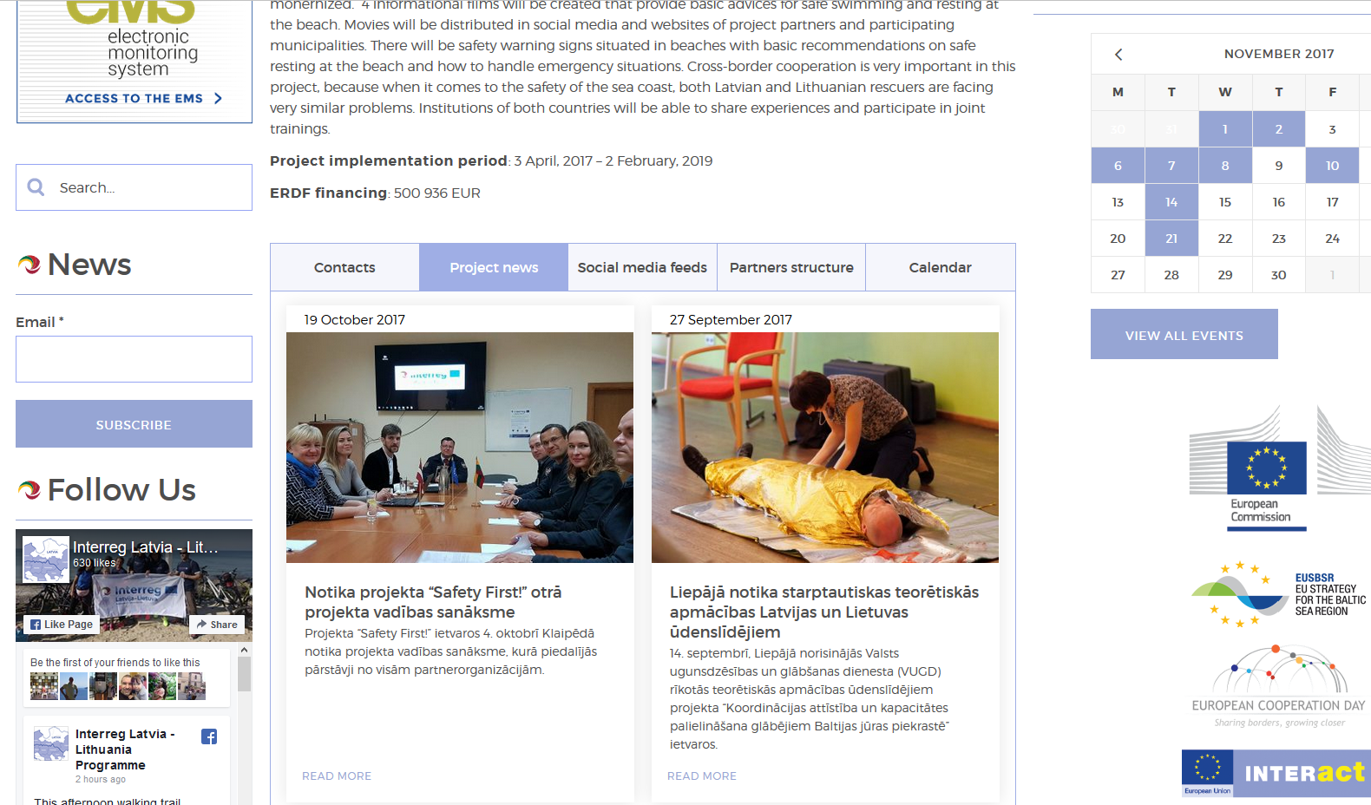
Project section on www.latlit.eu
Use good language
Describe existing situation and what the project will change
Indicate project implementation period
Indicate ERDF financing
Active project news section
Active social media feeds
Active calendar
Enter object locations on the map
latlit.eu/coordination-development-and-capacity-building-of-rescuers-along-baltic-seashore-safety-first-no-lli-92/

Slide 17


Informative posters
Mandatory: at least A3 size informative posters at premises of each project partner.
Project title should be in the colour of the Programme priority
Use plain language to explain aim of the project and other information

Slide 18




Colours of the Programme Priorities
Sustainable and clean environment
Labour mobility and employment
Social inclusion
Efficient public services

Slide 19

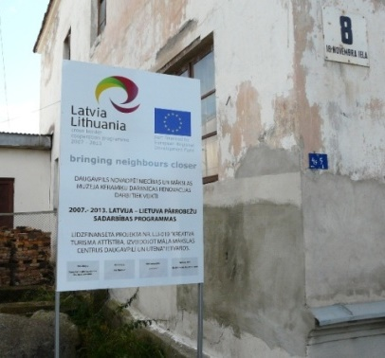
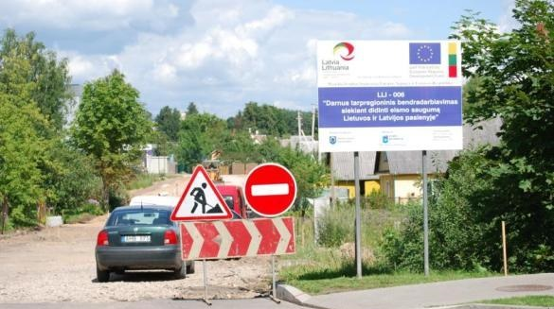
Marking of infrastructure objects
Mandatory for project with infrastructure works:
temporary billboard latter replaced by a permanent billboard or plaque in case the total costs planned for the infrastructure or (re)construction within the project exceeds
500 000 EUR in one site
  At least 5 years after the finalization of the project.
In other locations of project investments (for example public spaces, buildings, equipped premises) each project is recommended to put up a permanent plaque or a billboard of significant size.
General information plaques will be provided by JS

Slide 20
Articles, press releases and other information
Mandatory: at least two press releases
  - to media in Latvia and Lithuania
If reported as deliverable must contain:
Programme logo
Project title
A disclaimer
Information about financial support of the Programme.
Address of a website where more information is available
Copies of all press releases and articles must be sent to JS.
in Latvian and Lithuanian,
and/or in English and other languages
Distribution of information to international media is encouraged

Slide 21
Labeling of equipment
Mandatory: labeling of equipment and purchases
Put stickers with the Programme logo.
Put plaque in premises if items are not movable.
  At least 5 years after the finalization of the project.
LP should request for stickers and plaques from
Janis.Vanags@varam.gov.lv

Slide 22
Events
All event materials must contain
1) programme logo, and
2) project title.
- use Programme template for list of participants
The EU flag and/or movable stands of the projects, containing the Programme logo have to be displayed at all events
Programme logo has to be placed in a clearly visible place
- photos showing placement of the logo must be provided with report
Not latter than two weeks before event:
- enter event in the calendar on the Programme website
- inform JS via eMS
Save for reporting lists of participants, photos and all related materials

Slide 23
Five musts of project communication
2. Make photos and videos
4. Inform JS about events two weeks in advance
5. Always check if your meet the project communication requirements
3. Keep evidences
1. Use the Programme logo and acknowledge EU support

Slide 24
Questions?

Slide 25
Thank you!
Paldies!
Ačiū!
Notes:
Thank you all!

