Slide 1
Development of study courses according PBL

Slide 2
What do you want to now and to practice today?
Notes:
These questions as reference points. You don‘t have to answer each of them. Only what you find important.

Slide 3
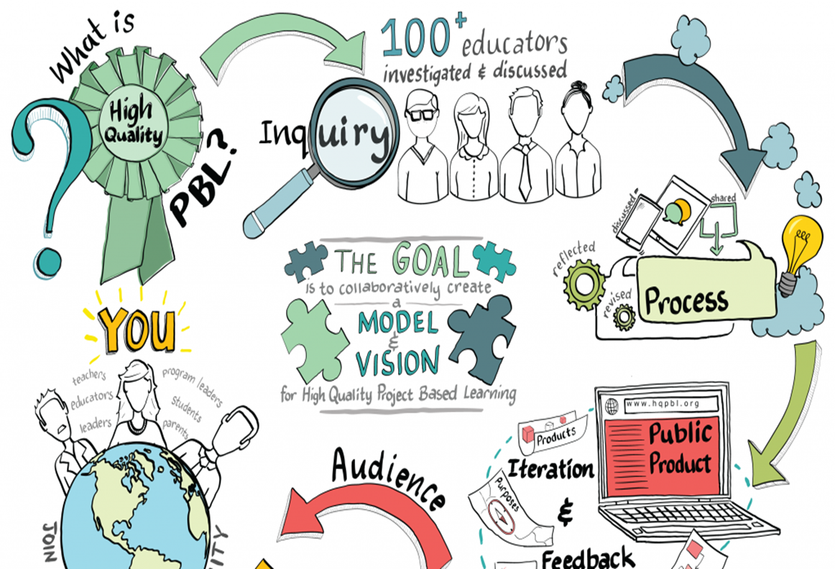
Structure of the Training Program

Slide 4
Responsibilities … ☺ ☹ ☺ (1)
Preparation of renewed study course syllabus according to problem-based learning method requirements where study results, student competencies developed, and student competency evaluation criteria are indicated.

Slide 5
Responsibilities … ☺ ☹ ☺ (2)
Reconstruction of study course teaching approach through planning practical assignments as the SalesLab workshops, where real life business problems will be solved in the frame of study course topics.

Slide 6
Responsibilities … ☺ ☹ ☺ (3)
Preparation of study guide for the improved study course which will introduce students to PBL approach and its application in their study course. Study results, requirements for student group and individual work, student evaluation system and criteria, possible approaches for problem solving, forms of consultations should be provided in the study guide (approx. 5 pages).

Slide 7
Responsibilities … ☺ ☹ ☺ (4)
Preparation of the needed study material in the MOODLE environment:
material required for studying the theory of the study course (files, links, PowerPoint presentations, video material, conspectus, etc.),
problem-solving algorithms according to the specific of the study course for real life business situation.
teacher –student on-line interaction tools foreseen (forums, chats, video conferences).

Slide 8
Program for this module
Why PBL – problem based and project based learning and definition of PBL– models and learning principles.
Methods for different study fields, class organisation techniques which help to develop student transferable skills as an important part of employability competence
Notes:
Bendra programos schema (

Slide 9
WHY PROBLEM BASED LEARNING IN HIGHER EDUCATION?
Describe yours
students… ☺

Slide 10
Different attitudes to studying (with reference to...)
Competing | Individual activity | Collaborating in group
When I achieve my aim, others will be unable to achieve it and vice versa. My success depends on whether I make it better than others. I do not want others to be as successful as me. I take care of myself, not others. I often compare myself to others. I am evaluated referring to norms. | Achieving my aim is unrelated to others. My success does not depend on success or failure of others. I am responsible for myself. I am evaluated referring to criteria. | I can achieve my aim if other members of the group achieve it as well. Success of the group depends on success of all members of it. We are all interested in success of the group and we strive to be successful. We take care of each other. Evaluation is based on criteria.

Slide 11
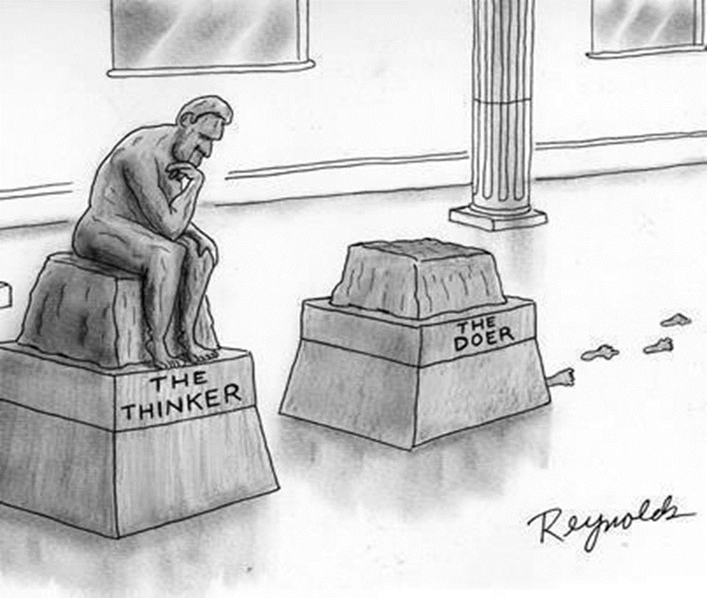
The gap between the skills people learn and the skills people need is becoming more obvious, as traditional learning falls short of equipping students with the knowledge they need to thrive.

Slide 13
What skills will change most?
Creativity will become one of the top three skills workers will need. With the avalanche of new products, new technologies and new ways of working, workers are going to have to become more creative in order to benefit from these changes.
Robots may help us get to where we want to be faster, but they can’t be as creative as humans (yet).
Whereas negotiation and flexibility are high on the list of skills for 2015, in 2020 they will begin to drop from the top 10 as machines, using masses of data, begin to make our decisions for us.

Slide 14
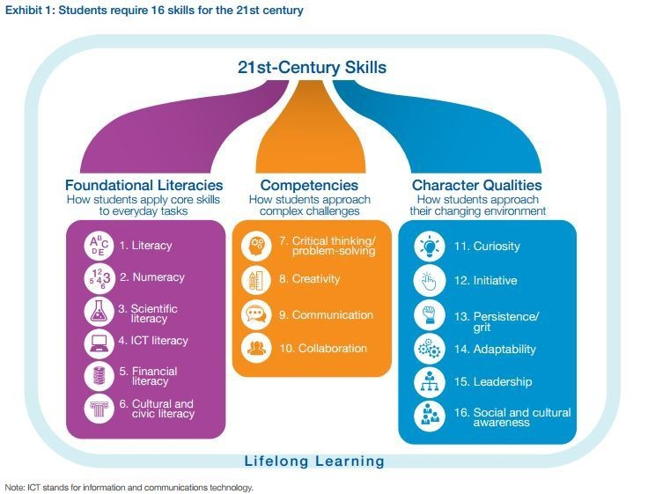

Slide 15
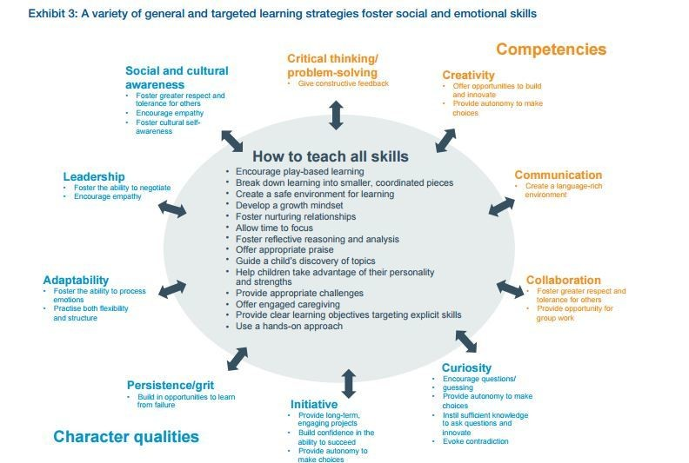

Slide 16
From
To

Slide 18
Notes:
Prisiminimui – kokie įspūdžiai apie darbą su LF?

Slide 19
Learning Conditions for PBL
No teaching
Secure learning environment
Active participation
Flexible speed
Different styles
Reflection

Slide 20
Pedagogy | Andragogy
Learners are told what they should learn | Learners know why they are learning certain things
Content of learning is based upon teacher’s knowledge | Content of learning is based on experience exchange between learner and teacher
Learners have little experience | Learners have a lot of experience
Learned knowledge and skills will be applied in the future | Learned knowledge and skills are applicable immediately after learning
Learning purpose has to be explained for learners | Learning purpose is clear for learners
Assessment of learning is teacher‘s responsibility | Assessment of learning is learners’ responsibility
Learning programme is arranged in fixed seuquence of topics | Learning programme is arranged in flexible modules
Learning needs are set by a teacher | Learning needs are set by learners
Motivation is based upon external factors | Motivation is based upon external and internal factors
Notes:
Aurimo medžiaga

Slide 21
Pedagogy – Andragogy (individual assessment)
Learners are told what they should learn
Learning needs are set by learners
Content of learning is based upon teacher’s knowledge
Motivation is based upon external and internal factors
Learners have little experience
Learned knowledge and skills will be applied in the future
Assement of learning is learners’ responsibility
Learning program is arranged in flexible modules
Learning purpose has to be explained for learners
Notes:
Aurimo medžiaga

Slide 22
Pedagogy – Andragogy – 2 (individual assessment)
Learners know why they are learning certain things
Learning needs are set by a teacher
Assessment of learning is teacher’s responsibility
Learning purpose is clear for learners
Learning program is arranged in fixed sequence of topics
Learned knowledge and skills are applicable immediately after learning
Content of learning is based on experience exchange between learner and teacher
Motivation is based upon external factors
Learners have a lot of experience
Notes:
Aurimo medžiaga

Slide 23
Let’s Talk Together ☺
Notes:
Visi bendrai patariam

Slide 24
Problem Based Learning…

Slide 25
Definitions of Key Terms (1)
Problem: A problem can be theoretical, practical, social, technical, symbolic-cultural and/or scientific and grows out of students’ wondering within different disciplines and professional environments.
Project : A project is a complex effort that necessitates an analysis of the target (problem analysis) and that must be planned and managed.

Slide 26
Definitions of Key Terms (2)
Exemplarity: Exemplarity is aprinciple of selecting relevant specific learning outcomes and content /scientific knowledge that is exemplary to overall learning outcomes.
THAT IS, A PROBLEM NEEDS TO REFER BACK TO A PARTICULAR PRACTICAL, SCIENTIFIC AND/OR TECHNICAL DOMAIN.

Slide 27
Definitions of Key Terms (3)
Team: A team is a group, sharing and working closely together in design, decision making, analysis and reflection.
Supervisor: The role of supervisor is one most often held by a faculty member serving as a resource for groups of students engaged in project work. Each student group has one or more supervisors for a project.

Slide 28
CENTRAL PRINCIPLES OF PBL
Problem orientation
Project organization
Integration of theory and practice
Participant direction,
A team-based approach,
Collaboration and feedback

Slide 29
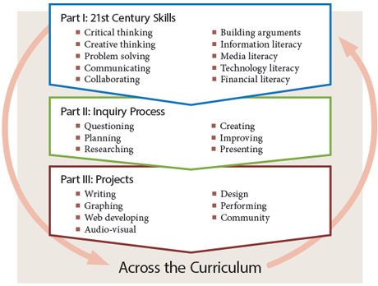
Project-Based Learning helps to develop

Slide 31
Differences between traditional and Problem-based learning
Traditional learning | Problem-based learning
Theoretical aspects little related to real life are analyzed | Student learns to apply knowledge to real life situations
Student uses information | Student creates information
Lecturer asks, student answers | Student raises questions and searches for answers
Student studies what has been assigned to him/her | Student studies sources found by himself
Students passively listen to a lecturer in a large group | Students work in small groups
Learns from lecturer | Learns from other students
Learns by competing with other students | Learns by cooperating
Studies to pass exam | Studies to understand
Struggles with straightforward facts | Sees practical applicability of what he/she has learnt
Refers to textbooks | Refers to a large number of various sources

Slide 34
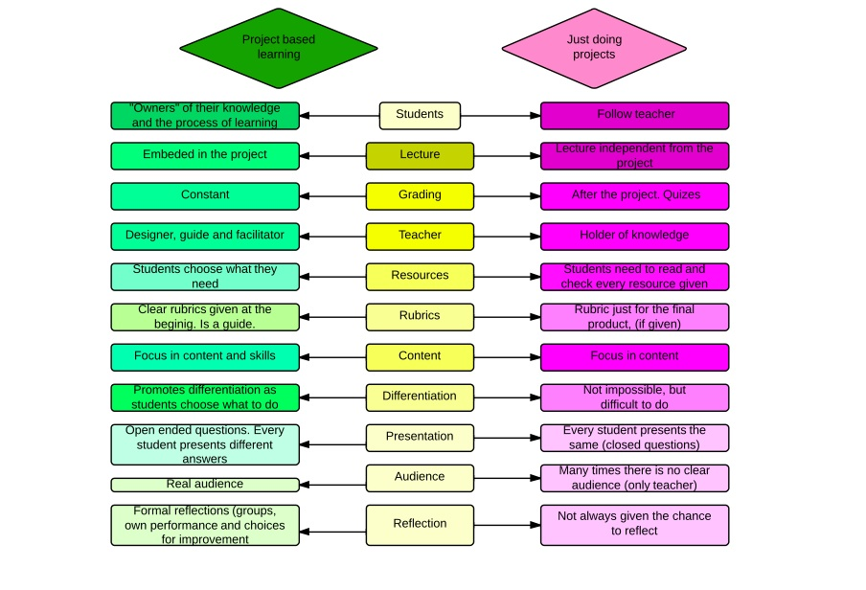

Slide 36
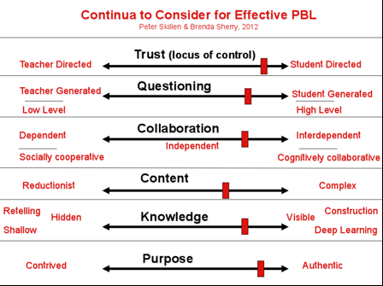

Slide 37
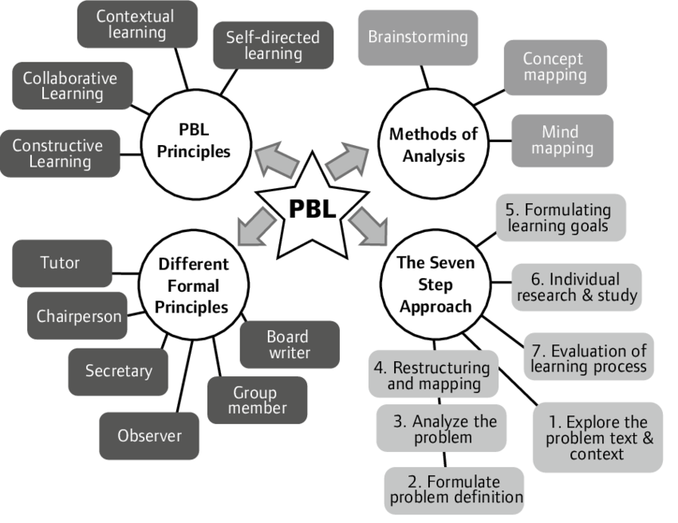

Slide 38
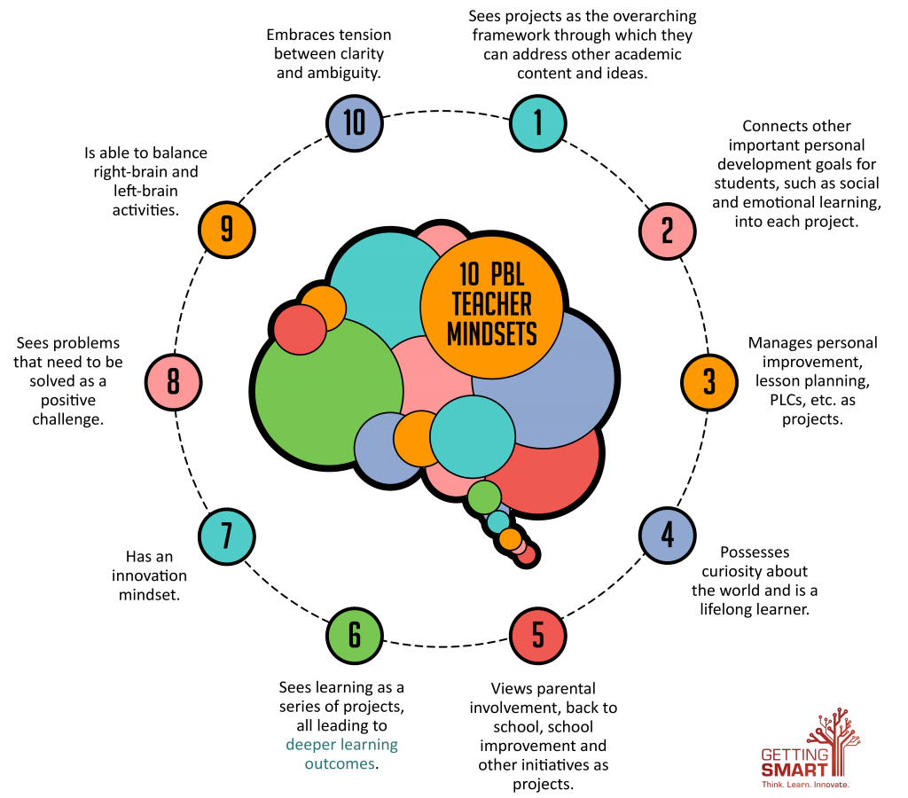

Slide 39
Dynamic facilitation of PBL ...
List of concerns/
questions
(what is important for us, what we need to discuss and elaborate ? )
Important question
(Priorities chosen from the list of concerns)
Ideas and solutions
(ideas, suggestions, what/how should be done)
Data, facts
(What do we know about the situation?)
Risks
(what is unclear and uncertain)

Slide 40
Dynamic facilitation
Rules
Everybody is speaking by turn
One can talk about any area
The speaker holds a „microphone“
The listeners do not comment, just listen
We‘ll return to the each area as many times as it will be nessecary
You can revise and complement your previous suggestions.

Slide 41
Powerful questions
Powerful questions
Why?
How?
What? Where? When?
Which?
Yes/no questions
Less powerful questions

Slide 42
Powerful questions. Examples
Powerful questions
Less powerful questions
What is it that you really want to be and do?
What are you doing really well that is helping you get there?
What are you not doing well that is preventing you from getting there?
What will you do differently tomorrow to meet those challenges?
How can I help / where do you need the most help?
Notes:
Eglė įkels

Slide 43
Reflections after the day
Topics discussed
Questions
Thoughts
Ideas
Reflections
Yellow sheet ☺

Slide 45
Lunch

Slide 46
See you tomorrow ☺

Slide 47
Good luck ☺

