Slide 1
Development of study courses according PBL
Joint teacher Problem Based Learning trainings
14-11-2017
Šiauliai

Slide 2
RECAP OF PREVIOUS THEMES / TOPICS
What do you remember from the previous seminar?

Slide 3
CENTRAL PRINCIPLES OF PBL
Problem orientation
Project organization
Integration of theory and practice
Participant direction,
A team-based approach,
Collaboration and feedback

Slide 4
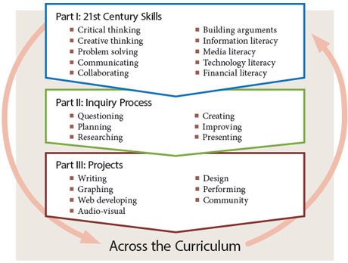
Project-Based Learning helps to develop

Slide 5
HOMEWORK…
☺ …
☹ …
???
Notes:
Prisiminimui – kokie įspūdžiai apie darbą su LF?

Slide 6
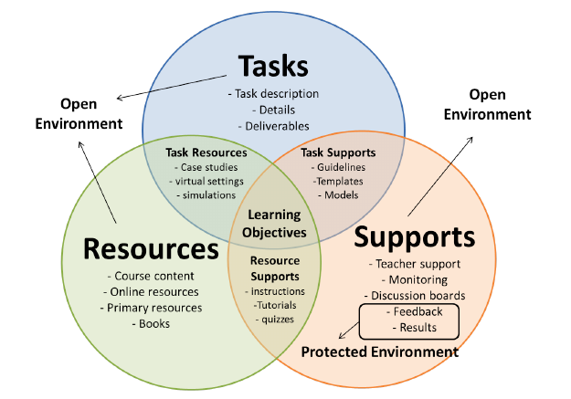
STUCTURE OF ORGANISATION PBL

Slide 7
Homework reflection
Speaker
Discussion in groups of 3
Listener
Writer
Topics to discuss:
How did the PBL learning process will go? What was OK or not so good acordin your’s study programme? What would you’ll do differently? What did you learn from conversation with your colleagues?
5-7 MIN. FOR EACH PERSON

Slide 8
TASKS, CHALLENGES AND RESPONSIBILITIES AGAIN…
Joint teacher Problem Based Learning trainings
14-11-2017
Šiauliai

Slide 10
Differences between traditional and problem-based learning (with reference to Azer, 2008)
Traditional learning | Problem-based learning
Theoretical aspects little related to real life are analyzed | Student learns to apply knowledge to real life situations
Student uses information | Student creates information
Lecturer asks, student answers | Student raises questions and searches for answers
Student studies what has been assigned to him/her | Student studies sources found by himself
Students passively listen to a lecturer in a large group | Students work in small groups
Learns from lecturer | Learns from other students
Learns by competing with other students | Learns by cooperating
Studies to pass exam | Studies to understand
Struggles with straightforward facts | Sees practical applicability of what he/she has learnt
Refers to textbooks | Refers to a large number of various sources

Slide 11
Responsibilities … ☺ ☹ ☺ STUDY COURSE SYLLABUS
… preparation of renewed study course syllabus according to problem-based learning method requirements where study results, student competencies developed, and student competency evaluation criteria are indicated.

Slide 12
Responsibilities … ☺ ☹ ☺ PRACTICAL ASSIGNMENTS as the SALESLAB WORKSHOPS
… reconstruction of study course teaching approach through planning practical assignments as the SalesLab workshops, where real life business problems will be solved in the frame of study course topics.

Slide 13
Responsibilities … ☺ ☹ ☺ STUDY GUIDE
… preparation of study guide for the improved study course which will introduce students to PBL approach and its application in their study course.
Study results, requirements for student group and individual work, student evaluation system and criteria, possible approaches for problem solving, forms of consultations should be provided in the study guide (approx. 5 pages).

Slide 14
Responsibilities … ☺ ☹ ☺ E-LEARNING SPACE IN MOODLE
Preparation of the needed study material in the MOODLE environment:
material required for studying the theory of the study course (files, links, PowerPoint presentations, video material, conspectus, etc.),
problem-solving algorithms according to the specific of the study course for real life business situation.
teacher –student on-line interaction tools foreseen (forums, chats, video conferences).

Slide 15
Questions
from
yesterday
Notes:
Čekin‘as iš vakar gal su fotokortom???

Slide 17
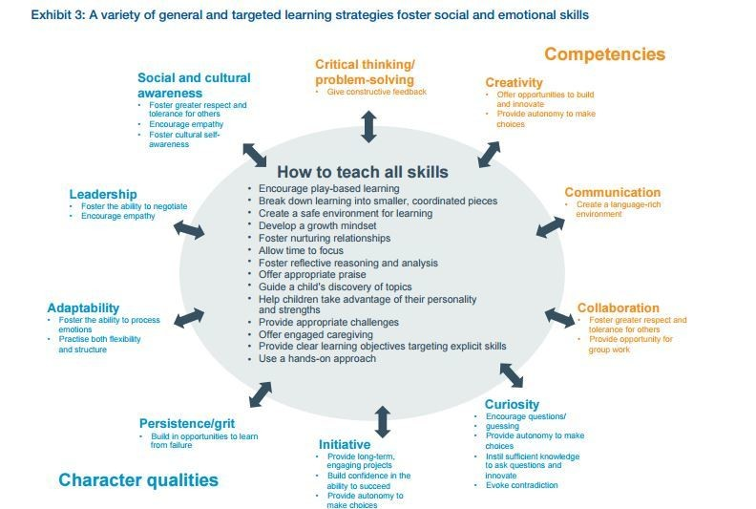

Slide 18
Quality of studies evaluation criteria, based on different educational paradigms (1)
Characteristics of educational paradigm | Requirements for the quality of studies
 | TEACHING | LEARNING
CONSTRUCTION OF THE STUDY PROGRAMME | The formed curriculum is presented, oriented towards the determined of knowledge and its reproduction in order to attain the learning standards. Ways and methods of the programme realisation are defined. | The study programme is formed after recognising previous learning results of the student. Curriculum is oriented towards the expansion of the individual experience; not all the results of studies can be predicted.

Slide 19
Quality of studies evaluation criteria, based on different educational paradigms (2)
Characteristics of educational paradigm | Requirements for the quality of studies
 | TEACHING | LEARNING
INTERACTION BETWEEN THE LECTURER AND THE STUDENT | The lecturer has a purposeful impact on the student. The authority of the lecturer is recognised. | The student is the most important figure in the process of studies. Active and conscious role of the student by interaction with educational environments and constructive creation of the own space for learning.

Slide 20
Quality of studies evaluation criteria, based on different educational paradigms (3)
Characteristics of educational paradigm | Requirements for the quality of studies
 | TEACHING | LEARNING
ROLE OF THE STUDENT | Student is an obedient listener, obeying the authority, repeating the thought of the lecturer and reproducing the gained knowledge. | The student formulates the aims of independent learning (maintaining the main line of the study programme), takes responsibility for them, forms the content of curriculum, and constructively assimilates acquired information.

Slide 21
Quality of studies evaluation criteria, based on different educational paradigms (4)
Characteristics of educational paradigm | Requirements for the quality of studies
 | TEACHING | LEARNING
EVALUATION OF RESULTS | The amount of the assimilated knowledge and skills of the student is evaluated. Orientation is geared towards reproduction of the knowledge of the presented subject and attaining of the standard. Evaluation criteria are set by the teacher. | Evaluation of the student is based on the recognition of previous learning results. The lecturer and the student agree on evaluation methods. The lecturer’s attention is paid to the self-evaluation, performed by the student (or their group).

Slide 22
General criteria of the quality of studies (1)
THE STUDY PROGRAMME
• A clear conceptual educational base (the didactical model) is selected, defining general principles of the programme construction and realisation.
• The conception of the of the future professional is defined.
• A clear match between the selected didactical model (based on educational paradigm) and the conception of the future professional.

Slide 23
General criteria of the quality of studies (2)
THE PROCESS OF STUDIES:
• The selected didactical model of the programme as well as the conception of the future professional is realised in the process.
•Contemporary methods of learning and teaching are applied in studies.
• Educational environment, corresponding to the needs of the students is formed in the study process.
• The process corresponds to the students’ expectations for the quality.

Slide 24
Dynamic facilitation: or how to solve problems about PBL integration…
List of concerns/
questions
(what is important for us, what we need to discuss and elaborate ? )
Important question
(Priorities chosen from the list of concerns)
Ideas and solutions
(ideas, suggestions, what/how should be done)
Data, facts
(What do we know about the situation?)
Risks
(what is unclear and uncertain)

Slide 25
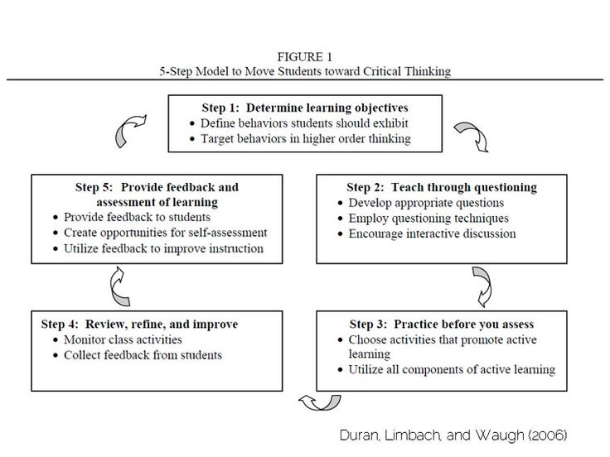

Slide 26
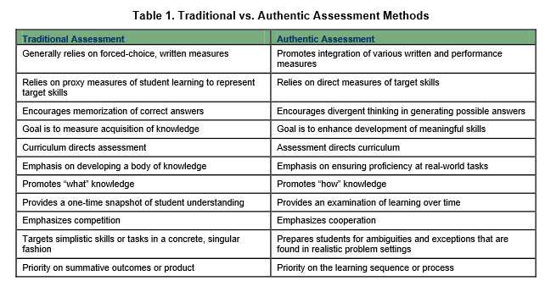

Slide 27
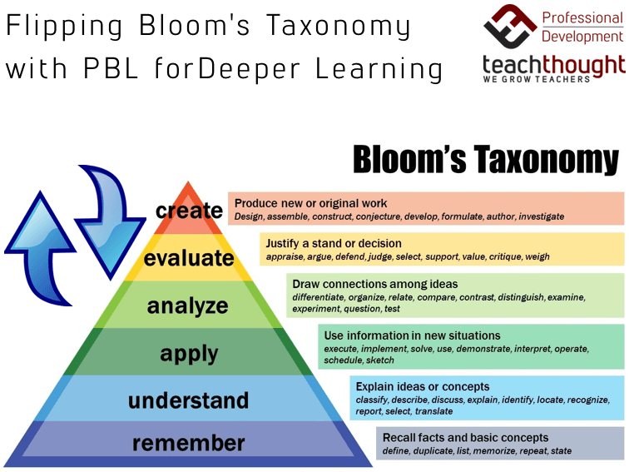

Slide 28
Good luck ☺

Slide 29
Reflection of the seminar
What learnings/findings I am taking with me?

