Slide 1
PRINCIPLES OF PROBLEM BASED LEARNING

Slide 3
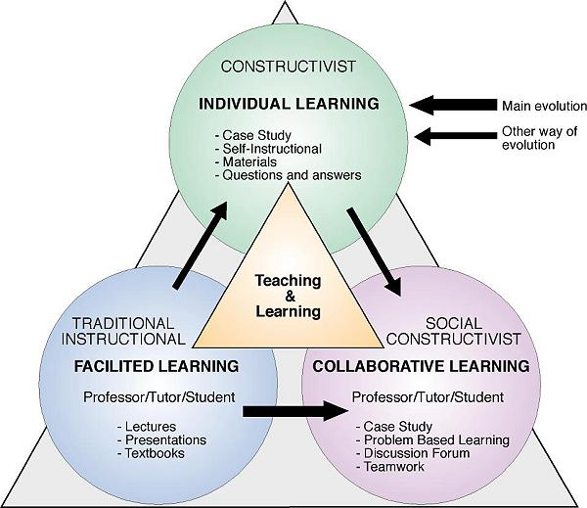
Educational Paradigms in Higher Education ( Debbie Heck, Bodil Ask, Åke Bjørke ir Ng Chong)

Slide 4
CENTRAL PRINCIPLES OF PBL
Problem orientation
Project organization
Integration of theory and practice
Participant direction,
A team-based approach,
Collaboration and feedback

Slide 5
Definitions of Key Terms (1)
Problem: A problem can be theoretical, practical, social, technical, symbolic-cultural and/or scientific and grows out of students’ wondering within different disciplines and professional environments.
Project : A project is a complex effort that necessitates an analysis of the target (problem analysis) and that must be planned and managed.

Slide 6
Definitions of Key Terms (2)
Exemplarity: Exemplarity is aprinciple of selecting relevant specific learning outcomes and content /scientific knowledge that is exemplary to overall learning outcomes.
THAT IS, A PROBLEM NEEDS TO REFER BACK TO A PARTICULAR PRACTICAL, SCIENTIFIC AND/OR TECHNICAL DOMAIN.

Slide 7
Definitions of Key Terms (3)
Team: A team is a group, sharing and working closely together in design, decision making, analysis and reflection.
Supervisor: The role of supervisor is one most often held by a faculty member serving as a resource for groups of students engaged in project work. Each student group has one or more supervisors for a project.

Slide 8
ASSESSMENT OF STUDENTS
Assessment of students’ group project work is conducted in a group setting and stands as the main assessment method.
Students’ project-related course work (i.e. project courses) is assessed within the context of the project work itself.
The institution’s academic programs, project work and research are responsive to the broader context in which the institution operates.

Slide 9
Partners…
Businesses and organizations with which the institution collaborates are able to articulate a clear understanding of the problem and project based pedagogical approach.

Slide 10
Questions…

