Slide 1
Financial Control (FC)
Meeting with Financial Controllers
08 November 2018, Kaunas

Slide 2
Introduction
FC Manual is issued for controllers/bodies performing FC functions for the Programme.
In Latvia FC is centralized and its functions are carried out by the Ministry of Environmental Protection and Regional Development.
In Lithuania a decentralized system is established by the Ministry of Interior.

Slide 3
Legal basis
Common Provisions Regulation (R1303/2013 of 17 December 2013), where Article 125(4) states that it has to be verified that:
Regulation (EU) No 1303/2013 of the European Parliament and of the Council of 17 December 2013
co-financed products and services have been delivered,
that expenditure declared by the beneficiaries has been paid out and that it complies with:
applicable law,
the operational programme,
the conditions for support of the operation.
Programme manual
of Interreg V-A Latvia–Lithuania Programme 2014–2020 for respective call of proposals

Slide 4
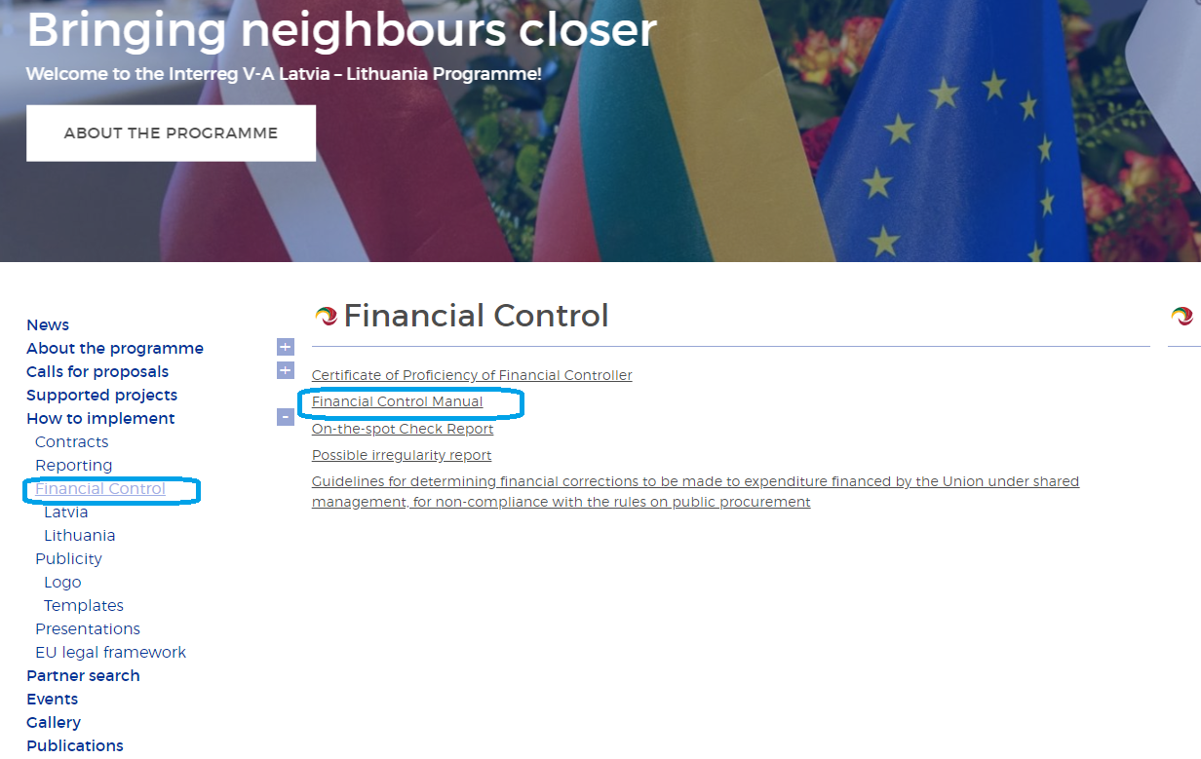
Financial Control Manual
http://latlit.eu/how-to-implement/financial-control/
Detailed instructions of verification of partner reports and filling checklist

Slide 5
Overview of the process
LP and PP submit their reports to the FC
FC verification and issuing of FC certificates
LP prepares and submits the consolidated progress report to the JS
Reports could be confirmed only in chronological order
Activity
2 weeks from the end of the reporting period
2 months after the partner report is submitted via eMS
2 weeks after the FC has issued FC certificates
Deadline
Total max time from
end of reporting period
2 weeks
2,5 months
3 months

Slide 6
Administrative checks
The verification shall cover each single reported cost item (sampling can be applied if foreseen in national rules for functioning of FC)
All supporting documents for each item of costs have to be uploaded in the eMS, except huge files as technical projects
Flat rates are automatically calculated by eMS

Slide 7
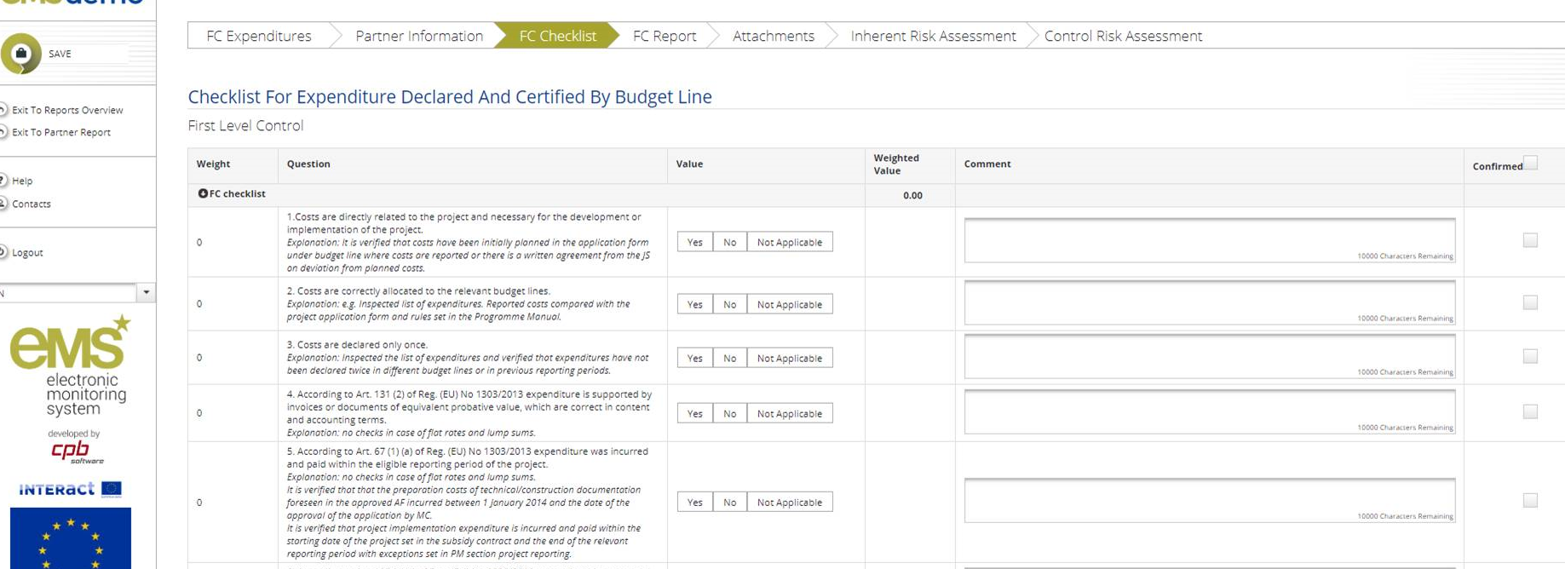
Administrative checks
FC Checklist: The information may be filled in the national language.
However, if the controller provided answer to any of questions “no” and/or deducted any costs reported by PP including applying financial corrections in comparison with the initially reported costs, justification/ reasoning in eMS should be provided in English language.

Slide 8
Administrative checks
In case ineligible cost items or deficiencies are found, they must be deducted by the controller
(in eMS section “List of expenditure”/”Edit expenditure”/ FC/ “Difference FC”)
Deductions and findings by FC should be reflected in the FC certificate, section “Description of finding, observation and limitations”.

Slide 9
On-the-spot checks & Irregularities
Interreg V-A Latvia–Lithuania Programme 2014–2020 On-the-spot Check Report
(Annex III)
Each Lithuanian FC shall go to at least one on-the-spot check for each controlled PP of each Project.
Report regarding Possible Irregularity
(Annex IV)
If the FC has detected possible irregularity (according to definition set in PM section Irregularities and recovery)

Slide 10
Changes/ Deviations
The Programme accepts a certain level of deviations from the project planned outputs,
deliverables and activities as set in application.
The PM section “Project changes” explains how such deviations should be handled in form of:
minor project changes
major project changes

Slide 11
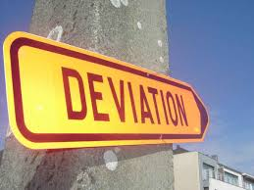
Changes/ Deviations
Depending on nature of deviations/ changes:
changes in the application form have to be introduced
OR
change has to be reported in the project report
(without prior approval of the JS).

Slide 12
Minor changes
Changes in the work plan
What changes? | What to do? (PP actions) | Restrictions?
Rescheduling project activities (for example, from period 1 to 3) | Communicate via progress reports
Adjustments in number of informative publications (for example, number of booklets, number of souvenirs etc.) | Communicate via progress reports !No restrictions in change of amounts | Planned target group can be reached Minimum communication requirements cannot be excluded Total costs planned for communication elements cannot be exceeded

Slide 13
Minor changes
Changes in the work plan
What changes? | What to do? (PP actions) | Restrictions?
Minor changes in planned activities/deliverables – affecting substance (for example, change in number of seminars, decrease of trained persons, new item is purchased etc.) | Request minor change in eMS Approval of JS Update in application form | Justification is provided There is no decrease in quality of activities/results Total BL sum cannot be exceeded
Other minor adjustments in planned activities/deliverables (for example, number of persons in meetings change, interrelated cost item is missing for expenditure under BL3 and 4 etc.) | Communicate via progress reports | Justification is provided There is no decrease in quality of activities/results Cost item is directly relevant for concrete activity Total BL sum cannot be exceeded

Slide 14
Minor changes
Changes in the budget
What changes? | What to do? (PP actions) | Restrictions?
Changes in costs within one BL (for example, costs for infrastructure works are higher, catering is more expensive than anticipated etc.) | Communicate via progress reports | Justification is provided There is no decrease in quality of activities/results Total BL sum cannot be exceeded Change can be applied for BL3-6 Reallocation of lump sum for preparation is not allowed
Changes in costs within one BL should be checked at project level, not PP level
( BL at project level cannot be overspend)

Slide 15
Minor changes
Changes in the budget
for BL1 (real cost method)
What changes? | What to do? (PP actions) | Restrictions?
Change in existing sub-budget lines Changes in number of units, unit rates, type,amount of employees, workload, changes in costs between planned items (e.g. staff costs for person from full - time to hourly rate is changed, workload for project manager from 70% to 50% and for project assistant from 50% to 70% | Communicate via progress reports | Principles of sound financial management are met Total amount of costs for BL cannot be exceeded
Change of number of employees and change of sub budget lines Changes in number of employees, creating new or merging existing sub budget lines | Request minor change in eMS Approval of JS Update in application form | Need for changes is strongly justified Principles of sound financial management are met Total amount of costs for BL cannot be exceeded

Slide 16
Minor changes
Changes in technical documentation
What changes? | What to do? (PP actions) | Restrictions?
Changes in building/technical documentation – doesn’t cause a change in AF (for example, technical solutions which are not described in activity/deliverable change) | Communicate via partner reports !!! Note: project partners are responsible for creation and submission of technical documentation in line with national legal acts | Information in AF is not affected

Slide 17
Changes/ Deviations
In eMS up-to-date budget is visible for the controllers
(except for situations of minor changes which don’t require JS prior approval and subsequent amendments in the application form)

Slide 18
Thank you! Paldies! Ačiū!
Notes:
Thank you all!

