Slide 1
Interreg V-A Latvia-Lithuania programme 2014-2020
INFORMATION SEMINAR
3rd Call for proposals
Specific Objective 1.2 and 4.1
Programme requirements

Slide 2
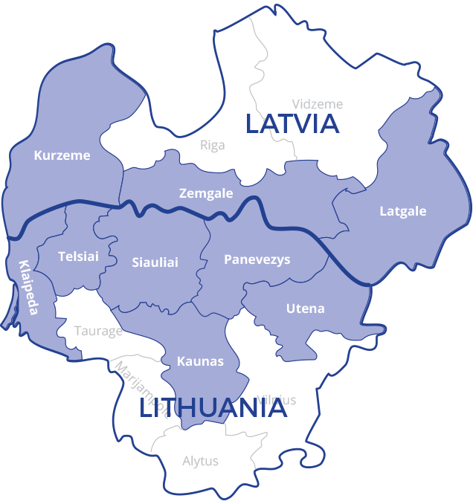
Programme
Objective
Contribute to the sustainable and cohesive socio-economic development of the Programme regions by helping to make them competitive and attractive for living, working and visiting
Programme territory
Programme budget
ERDF 69,6 mln. EUR
Indicative ERDF for the 3rd Call – 19,2 mln. EUR
Programme language
English (but supporting documents (e.g. technical documentation, cost estimations, invoices, etc.) can be in national languages)
www.latlit.eu
Interreg V-A Latvia-Lithuania Programme 2014-2020
www.latlit.eu

Slide 3
Information on approved projects within 1st and 2nd Calls for proposals
Allocation of ERDF for approved projects
Received applications 281
Approved projects 89*
*Excluding Direct award project

Slide 4
3rd Call for proposals
Programme priorities
1. Sustainable and clean environment through cooperation
3. Social inclusion as a precondition of territorial development
4. Improved quality of living through efficient public services administration
ERDF ~8,5 mln. EUR
ERDF ~5,0 mln. EUR
ERDF ~5,7 mln. EUR
Co-financed by the ERDF: 85% of the eligible project activities
* 2nd Priority is closed

Slide 5
3rd Call for proposals
Partnership requirements
Mandatory - at least 1 project partner from Latvia and 1 project partner from Lithuania
Who can apply:
Public authorities (national, regional and local authorities)
Public equivalent bodies, meaning by any legal body governed by public law
NGOs (NGO LP budget can be up to
200 000 EUR ERDF)
Lead Partner principle
LP
PP2
PP3
PP4
Interreg V-A Latvia-Lithuania Programme 2014-2020
www.latlit.eu

Slide 6
3rd Call for proposals
Timeframe
Submission of project applications in eMS: 9 April 2019 – 9 July 2019 (till 12:00)
Project application must be submitted by Lead Partner in English language
Project duration: Not longer than 24 months
Proposed starting date of the project: May – June 2020
Lead Partner Confirmation letter (must be completed by Lead partner organisation using this template and submitted as original in paper or submitted electronically signed by electronic signature to the JS by the Lead partner within period of time from the opening till the closing time of the call (post stamp))
For more information visit website www.latlit.eu
Programme Manual https://latlit.eu/wp-content/uploads/2019/04/Programme_Manual_3rd_call.pdf
Interreg V-A Latvia-Lithuania Programme 2014-2020
www.latlit.eu

Slide 7
PRIORITY I
Sustainable and clean environment through cooperation
Two specific objectives:
1.1. To increase number of visitors to the Programme area through improving and developing cultural and natural heritage objects, services and products
1.2. To increase integration and efficiency of environmental resource management
1. SUSTAINABLE AND CLEAN ENVIRONMENT THROUGH COOPERATION
ERDF ~8,5 mln. EUR
1.1 ~ 5.5 MEUR (ERDF)
1.2 ~ 3 MEUR (ERDF)
* 1.3 specific objective is closed​
1.1.Max. project size
EUR 800 000 (ERDF)
1.2.Max. project size
EUR 1 000 000 (ERDF)
Interreg V-A Latvia-Lithuania Programme 2014-2020
www.latlit.eu

Slide 8
PRIORITY I
Sustainable and clean environment through cooperation
SO 1.1. To increase number of visitors to the Programme area through improving and developing cultural and natural heritage objects, services and products
Indicative list of supported activities:
New joint sustainable touristic products and services
ICT solutions for products/services
Improvement of infrastructure for cultural and natural objects
Capacity building of involved stakeholders
Tangible/intangible joint cultural and natural heritage
Clustering and marketing
Interreg V-A Latvia-Lithuania Programme 2014-2020
www.latlit.eu

Slide 9
PRIORITY I
Sustainable and clean environment through cooperation
SO 1.2. To increase integration and efficiency of environmental resource management
Indicative list of supported activities:
ICT solutions
Creation, testing and application of new tools
Joint concepts, strategies, models and pilot actions
Strengthening of institutions‘ cross border cooperation
Planning and development of related equipment and infrastructure
Developing information
Construction and promotion of green infrastructure
Educational and awareness raising activities
Improvement of nature objects‘ infrastructure and equipment
Interreg V-A Latvia-Lithuania Programme 2014-2020
www.latlit.eu

Slide 10
PRIORITY III
Social inclusion as a precondition of territorial development
Two specific objectives:
3.1. To improve accessibility and efficiency of social services
3.2. To improve living conditions in deprived communities and territories
3. SOCIAL INCLUSION AS A PRECONDITION OF TERRITORIAL DEVELOPMENT
ERDF ~5 mln. EUR
3.1 ~ 3 MEUR (ERDF)
3.2 ~ 2 MEUR (ERDF)
3.1.Max. project size
EUR 600 000 (ERDF)
3.2.Max. project size
EUR 200 000 (ERDF)
Interreg V-A Latvia-Lithuania Programme 2014-2020
www.latlit.eu

Slide 11
PRIORITY III
Social inclusion as a precondition of territorial development
SO 3.1. To improve accessibility and efficiency of social services
Indicative list of supported activities:
Networking and exchange of experience
Improvement of infrastructure and equipment
Improvement of accessibility, efficiency and diversification of social services or social inclusion measures
Improvement of competencies of specialists
Informative campaigns
Vulnerable group’s need identification and assessment for changing/improving existing social services and social inclusion measures
Creation and improvement of labour market/educational activities/social life activities
Interreg V-A Latvia-Lithuania Programme 2014-2020
www.latlit.eu

Slide 12
PRIORITY III
Social inclusion as a precondition of territorial development
SO 3.2. To improve living conditions in deprived communities and territories
Indicative list of supported activities:
Activating deprived communities, solving problems, capacity building
Networking activities to activate deprived communities
Experience exchange, transfer of the best practices
Creating, upgrading, equipping social spaces
in the form of small scale investments up to 80 000 EUR ERDF per site (object) for deprived communities and territories
Educational activities, practical workshops and involvement of professional assistance
Interreg V-A Latvia-Lithuania Programme 2014-2020
www.latlit.eu

Slide 13
PRIORITY IV
Public services and administration
One specific objective:
4.1. To improve efficiency of public services by strengthening capacities and cooperation between institutions
4. IMPROVED QUALITY OF LIVING THROUGH EFFICIENT PUBLIC SERVICES AND ADMINISTRATION
ERDF ~5,2
mln. EUR
Max. project size
EUR 500 000 (ERDF)
Interreg V-A Latvia-Lithuania Programme 2014-2020
www.latlit.eu

Slide 14
PRIORITY IV
Public services and administration
4.1. To improve efficiency of public services by strengthening capacities and cooperation between institutions
Development and implementation of training and mentoring activities
Promotion of dialog between citizens and public services providers, societal involvement in civic decision making
Transfer of good practices, share of experience, development of innovative models or solutions
Activities aimed at new solutions for tackling cross border obstacles
Actions and improvement of small scale infrastructure and equipment
up to 100 000 EUR ERDF per site (object)
Integrated actions for simplification of administrative procedures and reduction of administrative burden
Interreg V-A Latvia-Lithuania Programme 2014-2020
www.latlit.eu

Slide 15
Activities NOT supported by the Programme
Purchase of land
Purchase of real estate
Purchase of not specialised cars
Purchase of luxury goods
Preparation of the technical documentation
Investment in infrastructure outside the Programme territory
Creation/improvement of long-term care services
Construction of roads for the applicants applying for the open calls
….full list of not supported activities by the Programme please read in section 3 of the Programme manual
Interreg V-A Latvia-Lithuania Programme 2014-2020
www.latlit.eu

Slide 16
General requirements for projects (1)
Clear link to the Programme
Is project overall objective coherent with the respective Programme priority and its specific objective?
Do project main outputs contribute to at least one output indicator and project results contribute to at least one result indicator of the chosen specific objective?
Clear cross border relevance
Do project partners solve common challenge addressed in the project by using cross border approach?
Do all the project partners benefit from the cross border cooperation?
Does cooperation bring added value, has a positive impact for the programme area and long-lasting effect after the project end?
Innovative approach is used
Does project offer new solutions that are different from already existing ones for chosen problem or territory?
Interreg V-A Latvia-Lithuania Programme 2014-2020
www.latlit.eu

Slide 17
Inovative apprroach
Project should demonstrate innovative approach – it should differ from already available cross border solutions for chosen problem or territory in order to avoid duplication of work and use of already known and available methodology. The project may make use of synergies with other past or current EU and other projects.
eco-innovative initiatives
new promotion methods
applying solutions from other areas
new services
new knowledge to the Programme area
new technologies
package offers
attracting attention
new solutions to the Programme area
‘are we talking about innovation like the Internet or innovation like adding wheels to suitcases’?
Interreg V-A Latvia-Lithuania Programme 2014-2020
www.latlit.eu

Slide 18
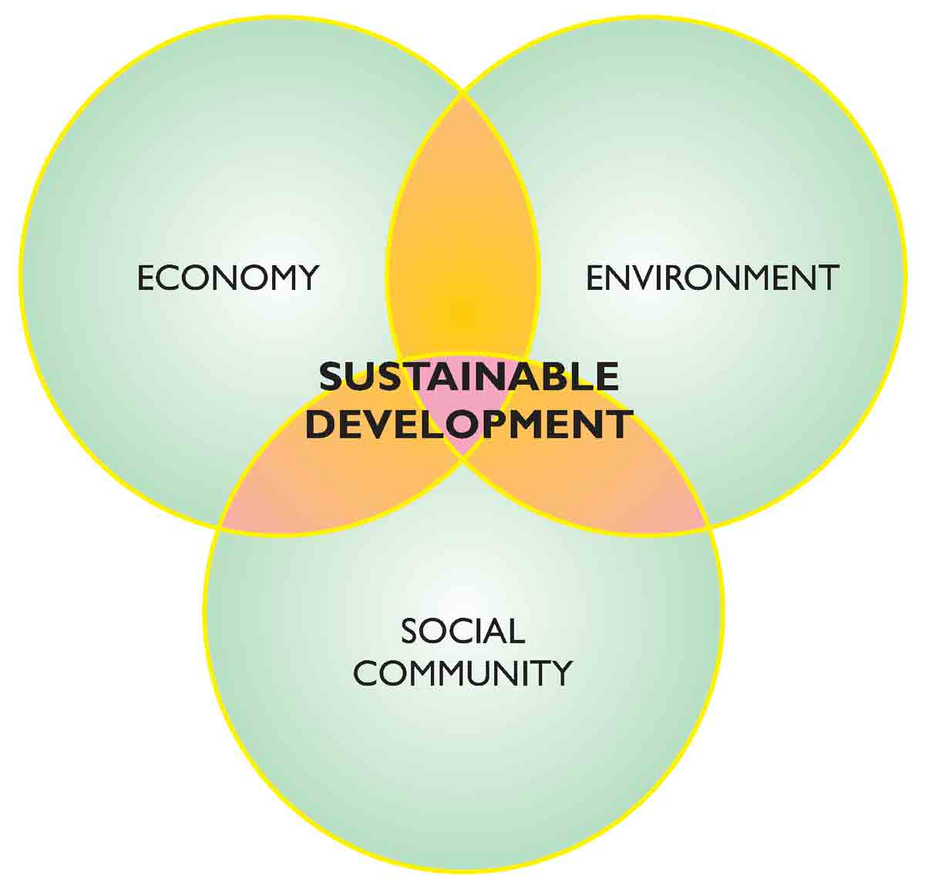
General requirements for projects (2)
Project results used by main stakeholders
Does application form state how main stakeholders (e.g. national, local municipalities) will use project results after project end if they are not involved in the project (e.g. university developing new social service)?
Durable and sustainable results
Does project produce results and establish structures that can exist beyond the lifetime of the project?
Do project partners foresee actions to ensure continuation of knowledge, services and benefits developed during the project?
Contribution to Programme horizontal principles
Is the project in line with horizontal principles of the Programme?
Interreg V-A Latvia-Lithuania Programme 2014-2020
www.latlit.eu

Slide 19
Specific objective:
1.2. To increase integration and efficiency of environmental resource management
ERDF ~3,0 mln. EUR
PROGRAMME PRIORITY No. 1
Sustainable and clean environment through cooperation
Max. project size
EUR 1 000 000 (ERDF)

Slide 20
Sustainable and clean environment through cooperation
Specific objective 1.2.
Specific objective: to increase integration and efficiency of environmental resource management
Why my project is needed?
How will my project influence Programme?
Result indicator
Number of organisations jointly contributing
to environmental resource management
Output indicator
Number of organisations supported

Slide 21
Sustainable and clean environment through cooperation
Specific objective 1.2.
The aim to improve integration and efficiency of environmental resource management by promoting cooperation among involved stakeholders at all levels.
Leads to higher capability to handle
protection and restoration of biodiversity and soil
promotion of ecosystem services
Active and coordinated cooperation of institutions and relevant stakeholders
Specific sustainable solutions for integrated and improved efficiency of environmental resources management

Slide 22
Natural objects
Protected areas
Risk management
Where joint environmental resource management could be applied?

Slide 23
Sustainable and clean environment through cooperation
Specific objective 1.2.
MUST HAVE for the project:
Ensure that project results will be used by main stakeholders
Address several environmental resources in both countries
Develop joint systematic management solutions used after project end
Provide clear reasoning for needed documentation and ensure its use after project end

Slide 24
Sustainable and clean environment through cooperation
Specific objective 1.2.
Indicative list of supported activities
Joint concepts, strategies, models and pilot actions.
Planning and development of related equipment and infrastructure.
Construction and promotion of green infrastructure.
Strengthening of institutions‘ cross border cooperation.
Developing information exchange and systems for managing and monitoring of
protected areas, safeguarding of ecosystems, and conservation and management of biodiversity.
Educational and awareness raising activities.
Improvement of nature objects‘ infrastructure and equipment.
Creation, testing and application of new tools.
ICT solutions.

Slide 25
Sustainable and clean environment through cooperation
Specific objective 1.2.
Mistakes of previous calls
Lack of justification of the problem and planned measures
Absent / not relevant data and information on baseline situation
Problem is described too broadly, connection with the local level is not clear
Too local scale of the problem
Lack of systematic solutions
Investments in infrastructure and equipment only
Public awareness raising only
Concentrated on scientific research
Lack of cross-border cooperation, partnership
„Mirror“ activities
Uneven involvement of project partners
Partners have no competences to solve indicated problems
Not clear durability of project results
Need and use of developed documents is not clear
Project results are not used by stakeholders or target groups after the end of the project
Durability of the started activities is not clear
Lack of innovation

Slide 26
Specific objective:
4.1. To improve efficiency of public services by strengthening capacities and cooperation between institutions
ERDF ~5,7 mln. EUR
PROGRAMME PRIORITY No. 4
IMPROVED QUALITY OF LIVING THROUGH EFFICIENT PUBLIC SERVICES AND ADMINISTRATION
Max. project size
EUR 500 000 (ERDF)

Slide 27
Public services and administration
Specific objective 4.1.
Specific objective:
To improve efficiency of public services by strengthening capacities and cooperation between institutions
How will my project influence Programme?
Why my project is needed?
Output indicator
Number of institutions,
participating in cooperation
Result indicator
Number of solutions
improving public services
Interreg V-A Latvia-Lithuania Programme 2014-2020
www.latlit.eu

Slide 28
Public services and administration
Specific objective 4.1.
The aim
of this
specific objective is:
Improve efficiency of public services by:
Raising capacity of public authorities and institutions by promoting legal and administrative cooperation in areas such as:
combating crime
improvement of civil security
protection of environment
2. Enhancing cooperation between citizens and institutions,
including capacity raising activities for municipalities with an aim to improve public services.
Interreg V-A Latvia-Lithuania Programme 2014-2020
www.latlit.eu

Slide 29
Public services and administration
Specific objective 4.1.
One of public service definitions is
a tangible or intangible benefit provided by public entity to a customer
by means of economic or administrative service
Interreg V-A Latvia-Lithuania Programme 2014-2020
www.latlit.eu

Slide 30
Public services and administration
Specific objective 4.1.
Activities must have to focus on:
Increasing capacity of institutions providing public services
Capacity building of employees providing public services, through:
cooperation networks,
experience exchange visits,
trainings,
workshops and consultations.
Interreg V-A Latvia-Lithuania Programme 2014-2020
www.latlit.eu

Slide 31
Public services and administration
Specific objective 4.1.
Activities must have to focus on:
Improving efficiency and accessibility of public services:
simplification of administrative procedures,
raising administrative cost-efficiency,
optimisation of public administration processes including development of interactive information
development/improvement of management tools and quality management systems and ICT solutions.
Investments should be oriented towards more efficient organisational processes and management.
Interreg V-A Latvia-Lithuania Programme 2014-2020
www.latlit.eu

Slide 32
Public services and administration
Specific objective 4.1.
MUST HAVE for the project:
Clear description how project results will be used by stakeholders after the project end,
especially when main stakeholders
are not involved in the project
Interreg V-A Latvia-Lithuania Programme 2014-2020
www.latlit.eu

Slide 33
Public services and administration
Specific objective 4.1.
Indicative list of Activities supported (if not covered by other Programme priorities):
Integrated actions for simplification of administrative procedures and reduction of administrative burden;
Promotion of dialog between citizens and public services providers and societal involvement in civic decision making;
Small scale investments (equipment and infrastructure) up to 100 000 EUR ERDF per site (object) for protection and security of civil society, combating crime, protection of environment etc.;
Interreg V-A Latvia-Lithuania Programme 2014-2020
www.latlit.eu

Slide 34
Public services and administration
Specific objective 4.1.
Indicative list of Activities supported (if not covered by other Programme priorities):
Development and implementation of training and mentoring activities
Transfer of good practices and development of innovative models or solutions for provision of necessary competences and human resources within public services
Activities aimed at new solutions for tackling cross border obstacles
http://ec.europa.eu/regional_policy/sources/docoffic/2014/boosting_growth/com_boosting_borders.pdf
Interreg V-A Latvia-Lithuania Programme 2014-2020
www.latlit.eu

Slide 35
Thank you for your attention
Please do not hesitate to contact us for any further information or visit www.latlit.eu

