Slide 1
ELIGIBILITY OF COSTS
Webinar on project implementation

Slide 2
Efficiency
Effectiveness
Economy
Eligibility of costs (1)
Sound Financial Management
Financial Regulation (No 966/2012 of 25 October 2012)
Economy - resources used by the institution for the pursuit of its activities shall be made available in due time, in appropriate quantity and quality and at the best price
c - best relationship between resources employed and results achieved
Effectiveness - attaining the specific objectives set and achieving the intended results
Latvia-Lithuania Cross Border Cooperation Programme 2014-2020
www.latlit.eu

Slide 3
Eligibility of costs (2)
Costs are directly related to the project and planned in the AF
Only costs incurred by PP and reported under the correct BL
Expenditure must have been paid out (“gone out of the PP bank account”)
Costs must be paid out within the project duration (with exceptions stated under subsection 7.3.1 “Project reporting” - preparation costs, LT FLC costs)
Expenditure does not exceed in the application form indicated:
a) eligible project budget;
b) each project partner budget
Interreg V-A Latvia-Lithuania Programme 2014-2020
www.latlit.eu

Slide 4
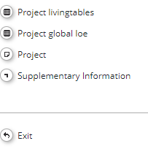
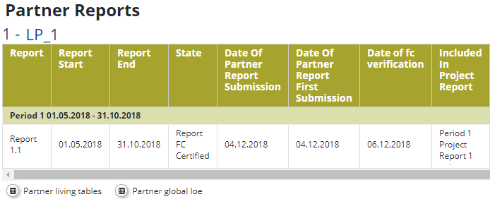
Eligibility of costs (3)
Self-control
After preparing and submitting each report, each project partner must make sure that the expenses incurred are in line with the planned budget.
The Project Lead Partner must check the total project budget.
Latvia-Lithuania Cross Border Cooperation Programme 2014-2020
www.latlit.eu

Slide 5
Eligibility of costs (4)
Competition and public procurement
Follow national procurement rules
Avoid artificial splitting of contracts and setting specifications artificially limiting competition
Ensure transparency, non‐discrimination and equal treatment
Thoroughly document the procedure and decision making
For deduction of costs in public procurement, Guidelines for determining financial corrections to be made to expenditure financed by the Union under shared management, for non-compliance with the rules on public procurement (Commission Decision of 19.12.2013 C(2013) 9527 final) applies.
Interreg V-A Latvia-Lithuania Programme 2014-2020
www.latlit.eu

Slide 6
Eligibility of costs (5)
Costs proved by delivery of works, services or supplies
Advance payments are eligible only after the partial or full delivery of the purchased goods or services.
In case up to 1/3 of total contract amount is paid as advance payment foreseen in the contract, then proof of partial or full delivery of goods or services is not required
costs which were paid in previous reporting periods but exceeded allowed threshold of advance payment of 1/3 of the total contract amount for service or goods, can be reported in any of next reports provided that full delivery of goods or services has taken place;
Interreg V-A Latvia-Lithuania Programme 2014-2020
www.latlit.eu

Slide 7
Eligibility of costs (6)
Ineligible costs
Ineligible costs:
Fines, financial penalties and expenditure on legal disputes and litigation
Costs related to fluctuation of foreign exchange rate
Interest on debt
Recoverable value added tax
Charges for national financial transactions
Interreg V-A Latvia-Lithuania Programme 2014-2020
www.latlit.eu

Slide 8
Eligibility of costs (7)
Ineligible costs
No sub-contracting Between PP’s and staff employed in the project
No double financing
Avoiding corruption and conflict of interest
Geographical eligibility
not considered if:
promotional purposes;
participation in project/MA/JS/FC events;
consultations/meetings with FC;
considered if project activity is implemented or partner is located outside of Programme area/ prior approval from the Programme needed
Interreg V-A Latvia-Lithuania Programme 2014-2020
www.latlit.eu

Slide 9
Eligibility of costs (8)
Requirements for accounting system
Requirements for accounting system
Separate accounting system or project specific accounting code to record project costs
All related payments of the project have a clearly distinguishable book-keeping code
Exact reported amount is indicated on the invoice in case the invoice is partly reported to the Programme
In addition, it is strongly recommended that project index is written or stamped on original invoices reported to the Programme
Book-keeping lists/overviews ‒ i.e. list of all expenditures for all transactions relating to the project without prejudice to national accounting rules
Interreg V-A Latvia-Lithuania Programme 2014-2020
www.latlit.eu

Slide 10
Eligibility of costs (9)
Audit trail
Audit trail
LP is responsible to ensure that an adequate audit trail is documented at all levels of the project, including project partners’ expenditure
Therefore, the LP has an overview on:
who paid
what was paid
who verified, and where the related documents are kept
who is the contact person of the project partner
Interreg V-A Latvia-Lithuania Programme 2014-2020
www.latlit.eu

Slide 11
Eligibility of costs (10)
Audit trail
Audit trail
Keep the documents related to the project in a safe and orderly manner at least 5 years after the final payment has been made by the MA to the LP
Documents (evidence of the project outputs, copies of brochures, photos, recordings) should be archived separately in a project folder with a reference to the place where the original documents are kept
Interreg V-A Latvia-Lithuania Programme 2014-2020
www.latlit.eu

Slide 12
Eligibility of costs (11)
Deduction of costs
The costs reported within the project can be reduced and declared ineligible by:
Financial Control
Visible in FC certificate and in Partner report/ «View Report» /section «Partner report overview»
Managing Authority / Joint Secretariat
Visible in eMS section «Project livingtables»
Certifying Authority
Visible in eMS section «Project livingtables»
Latvia-Lithuania Cross Border Cooperation Programme 2014-2020
www.latlit.eu

Slide 13
Thank you! Paldies! Ačiū!
Notes:
Thank you all!

