Slide 1
Reporting in EMS The most important aspects to avoid mistakes

Slide 2
BEFORE REPORTING
Before reporting, Lead partner (LP) checks if information in section
„Supplementary information“ is filled in:
- information on LP’s project management staff
- Bank account + confirmation of financial information (Guidance how to implement project via eMS, Annex 2)
- specify Financial control (FC) institution (only for partners from Lithuania)
- assign user rights for each project partner so that they would be able to access application and reporting
- attach signed Partnership agreement

Slide 3
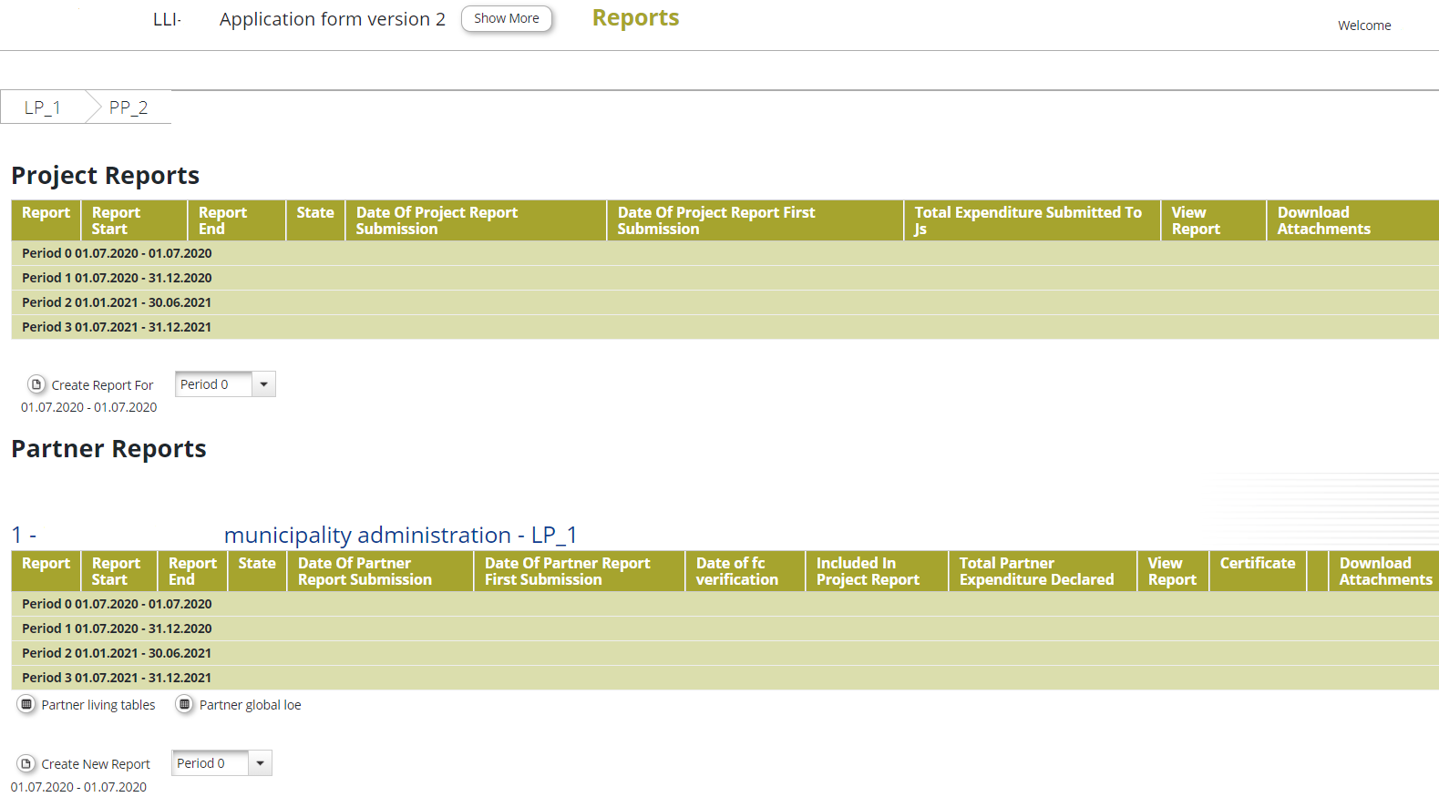
http://latlit.eu/how-to-implement/reporting/
REPORTING IN EMS

Slide 4
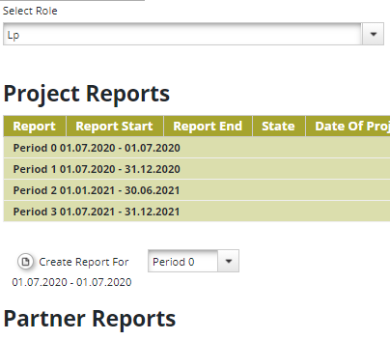
REPORTING IN EMS
In eMS each Partner sees own Partner report
LP with role “PP” sees own Partner report
LP with role “LP” sees Project progress consolidated report, own Partner report and reports of all partners

Slide 5
TYPES OF REPORTS
Submited by each Project partner
Content part on implemented activities/deliverables on partner level
Financial part – section ‘List of expenditure’ (attach invoices, other financial documents)
Certified by FC
Partner report
Submited by Lead partner
Consolidated progress report
Content part on implemented activities/deliverables/project main outputs on project level
Financial part – attach FC certificates for each project partner
Serve as basis for payments from the Programme to the LP
Final report
(together with final consolidated progress report)
Final content report on all implemented activities/deliverables/project main outputs on project level

Slide 6
GENERAL TIPS FOR REPORTING
Submit partner and consolidated reports on time. Don’t delay!
Always prepare reports in consequent order (e.g. for 1st, 2nd, 3rd period)
Do not forget to prepare and submit reports for 0 period:
Partner reports with 0 EUR expenses - to LP
Partner reports with reported costs - to FC
Partner reports for other periods with 0 EUR expenses - to FC
Do not delay submission of clarifications to FC or JS
Carefully check issued FC certificate (e.g. confirmed, postponed costs, ineligible costs)

Slide 7
PARTNER REPORT
Content part
Financial part
Evidences – photos, list of participants, prepared studies, etc.
Information on progress made within the period by project partner – achieved outputs, deliverables
Reported expenditure
Justify with procurement, financial documents, book-keeping extracts

Slide 8
IMPORTANT TO KNOW Partner report
Content part - section “Report”
Tips based on common mistakes:
Provide exhaustive summary of partner’s work during respective reporting period.
Specify values of reached target groups.
Describe minor changes and deviations occurred during reporting period.
In WPs provide information on implemented deliverables and project main outputs.
If achievement of deliverables is delayed, provide reasons for delay and provisional timeframe for implementation.
If deliverable is achieved but costs will be included in the next report, specify this in description of deliverable.
If deliverable reported in previous but costs reported in current report, inform about that.
Read section 11 of the Guidance how to implement project via eMS

Slide 9
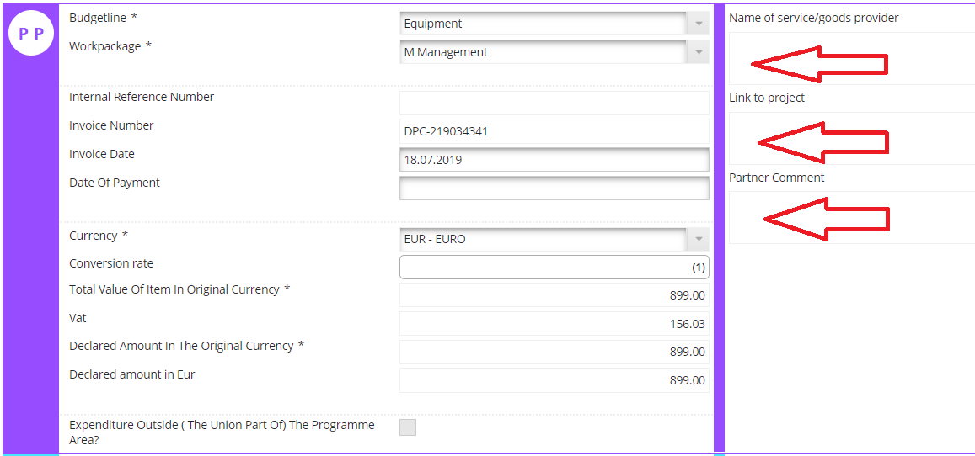
IMPORTANT TO KNOW Partner report
Financial part – section “List of expenditure”
Provide description of costs - describe them in relation to deliverables/activities.
Check if reported costs are planned in partner budget. If not, consult with LP/JS and request project changes, if necessary.
Provide supporting documents for reported costs (procurement, financial, evidence of delivered services/works).
Based on common mistakes from finished and ongoing projects….

Slide 10
IMPORTANT TO KNOW Partner report
Evidences - supporting documents
Project main outputs – final versions of documents for project main outputs
Reporting per work package – documents for deliverables (lists of participants from events, photos, researches, materials, etc).
List of expenditure – procurement documents, financial documents, evidences of delivered services or products to justify reported costs
Attachments – documents that cannot be uploaded in other sections of the report, e.g. book-keeping policy of institution, bank statement, etc.
Follow rules on creation of files with documents (e.g. the file name shall contain number of deliverable and topic of the document attached, e.g. “D.M.1.1_Agenda_WG_meeting.pdf)
Read rules on uploading supporting documents in Partner report on page 27 of the Guidance how to implement project via eMS

Slide 11
CONSOLIDATED PROGRESS REPORT
Content part at
project level
Attached FC certificates for relevant period
Evidences – photos, list of participants, delivered documents, etc.
Information on progress made in the reporting period in project – achieved outputs, deliverables, etc.

Slide 12
IMPORTANT TO KNOW Consolidated progress report
Content part - section “Report”
Information on project progress in reporting period, achievement of project specific objectives, target groups, indication for problems and solutions found at project level, attached FC certificates.
Tips based on common mistakes:
Provide full and clear summary of work done by partners during reporting period.
Specify values of reached target groups and describe; indicate problems/solutions found at project level.
Don’t forget to attach partner FC certificates and check if they are for correct period.
Read section 12 of the Guidance how to implement project via eMS

Slide 13
IMPORTANT TO KNOW Consolidated progress report
Content part - section “Workpackages”
Reporting on implemented activities, deliverables, project main outputs, problems or minor changes per each WP at project level.
Tips based on common mistakes:
Be specific and precise! Provide full and exhaustive information on partners’ work, description of reached deliverables, minor changes or deviations occurred; indicate responsible partners. It’s not sufficient to specify few words or one sentence.
2) Always check if information on reported deliverable matches with planned in the application form; describe achievements only of particular period and don’t mix with work done earlier. That’s confusing!

Slide 14
IMPORTANT TO KNOW Consolidated progress report
3) Indicate progress in achievement of deliverables rather than making references to partner reports (e.g. D.T1.1.1 Achieved. Please see PP2 report.)
4) Clearly describe progress for deliverables that are partly reported (e.g. 4 out of 10 meetings). Indicate number of meetings organized in previous periods, current and for the next, so that the status is clear.
5) Specify correct statuses for activities/deliverables/outputs/work packages.

Slide 15
IMPORTANT TO KNOW Consolidated progress report
Evidences - supporting documents
Project main outputs/WP Implementation/WP Investment - final versions of documents for achieved project main outputs.
WPs Management/Implementation/Investment/Communication” - documents for achieved deliverables.
Attachments – other documents, e.g. Confirmation letter.
Read rules on uploading supporting documents in Project report on page 43 of the Guidance how to implement project via eMS

Slide 16
IMPORTANT TO KNOW Consolidated progress report
Evidences - supporting documents
Follow rules on creation of files with documents:
(e.g. The file name shall contain number of deliverable, topic of the document attached and title of the partner, e.g. “D.T1.1.1_Research_LP.pdf)
If document already uploaded in Partner report,
specify path to it in deliverable description: e.g. “Supporting documents for organized seminar are available in PP2 report, section “Report”, deliverable D.T1.1.1”.
Read rules on uploading supporting documents in Project report on page 43 of the Guidance how to implement project via eMS

Slide 17
IMPORTANT TO KNOW Partner report & Consolidated progress report
Tips based on common mistakes for supporting documents:
Check if supporting documents for achieved deliverables/outputs and reported costs (in Partner report) are attached (full set of documents not just one or few).
2) Attach documents in correct places and name them according to rules for creation of files with documents.
3) Don’t attach all documents in section “Attachments” named in national languages or with unclear names (e.g. Doc1.doc).
4) In consolidated progress report provide clear links to documents available in Partner reports.

Slide 18
IMPORTANT TO KNOW Partner report & Consolidated progress report
5) Always attach documents provided during clarification process for JS/FC to the report.
6) Provide active links to the project online deliverables (e.g. data bases, websites, articles in media) and/or attach print-screens.

Slide 19
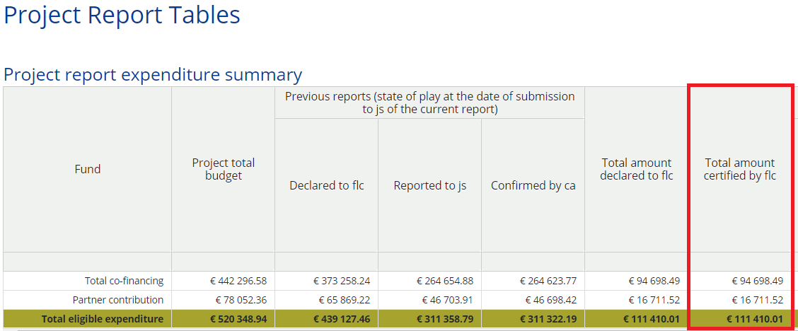
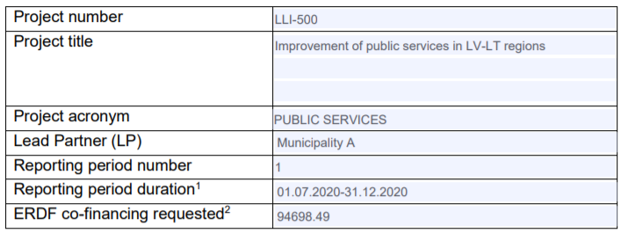
IMPORTANT TO KNOW Consolidated progress report
7) Submit Confirmation letter for each progress report and check if it is correct.

Slide 20
IMPORTANT TO KNOW Final report
To do list for the Final report
Harmonise Final report file in word format with JS
Attach statements after project implementation from each PP
Indicate the level of achievement of project specific objectives “fully achieved”
Ensure that main outputs achieved, documentation evidences are attached to the report and in Supplementary Information / Outputs
Update Project summary and fill in section Project results on the Programme’s webpage
Templates of documents for final report are here: https://latlit.eu/how-to-implement/reporting/
Read section 13 of the Guidance how to implement project via eMS

Slide 21
In case of questions
Be positive ☺
Read Programme Manual – https://latlit.eu/how-to-implement/
Read Guidance how to implement project via eMS - https://latlit.eu/wp-content/uploads/2020/04/Guidance-how-to-implement-project-via-eMS_v4_0.pdf
Write an email or call to Joint secretariat - https://latlit.eu/contacts/

