Slide 1


COMMUNICATION REQUIREMENTS FOR PROJECTS
Communication webinar

Slide 2
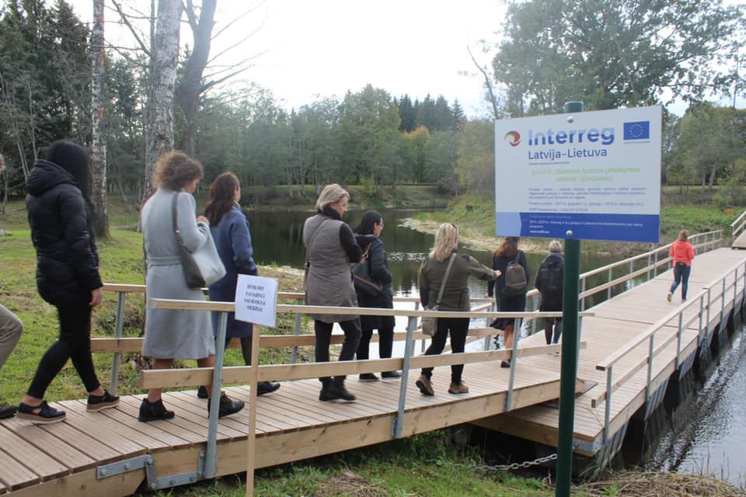
Follow the publicity requirements so that everyone knows your project and everything is fine with the project finances!

Slide 3

Visibility rules for projects
8 mandatory communication requirements described in Communication Guidelines
Frequently made mistakes
Use it as check-list!

Slide 4
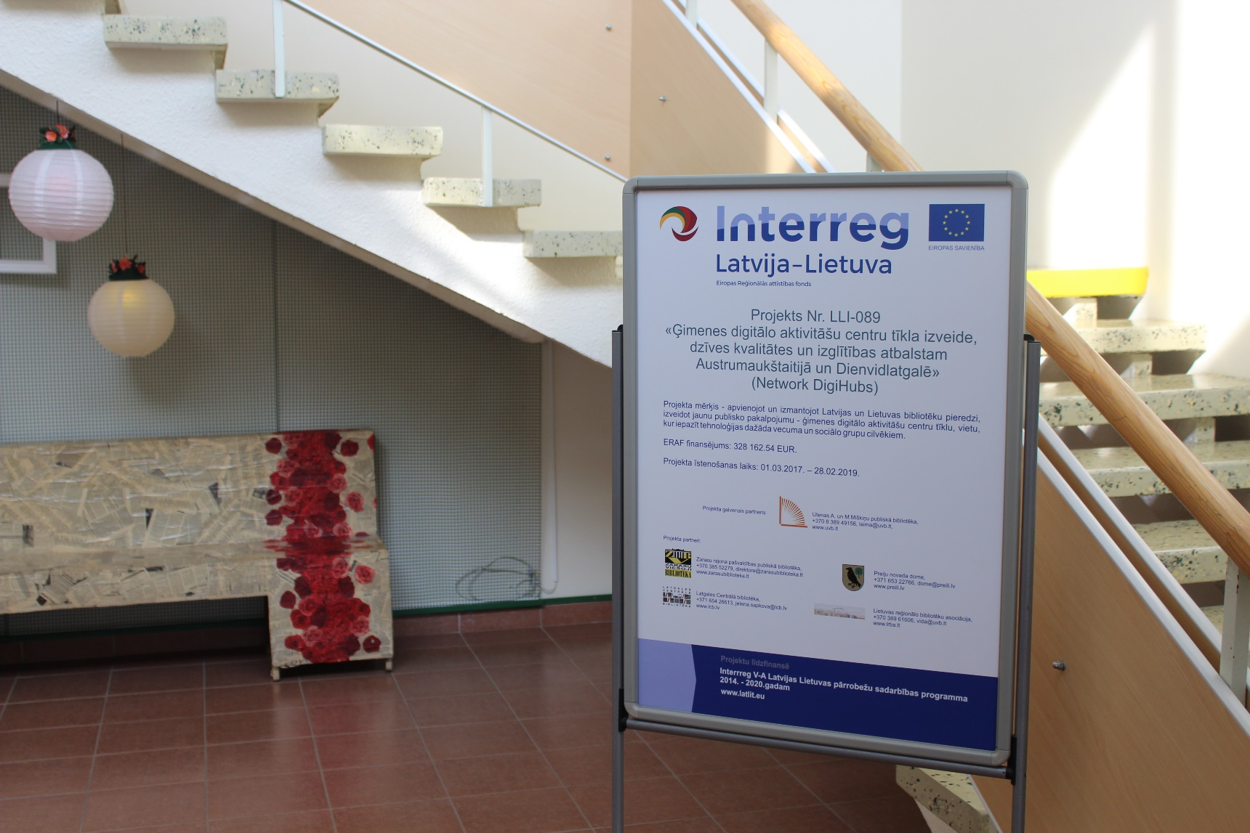
Project communication elements required by the Programme
  Informative posters (at least A3 size) at premises of each project partner.
  Use prepared template.

Slide 5
Websites of project partners
Common mistakes
Section is difficult to find
No project number or acronym
Not updated
No other mandatory information
Bad language
Wrong colors of logo
Not informative
Other logos larger than EU emblem
Everything put under «projects» or «news»
Mandatory: project information on website of each project partner
Accessible with 3-4 clicks
@LatviaLithuaniaProgramme
No scrolling to see logo of the programme
Relevant location

Slide 6
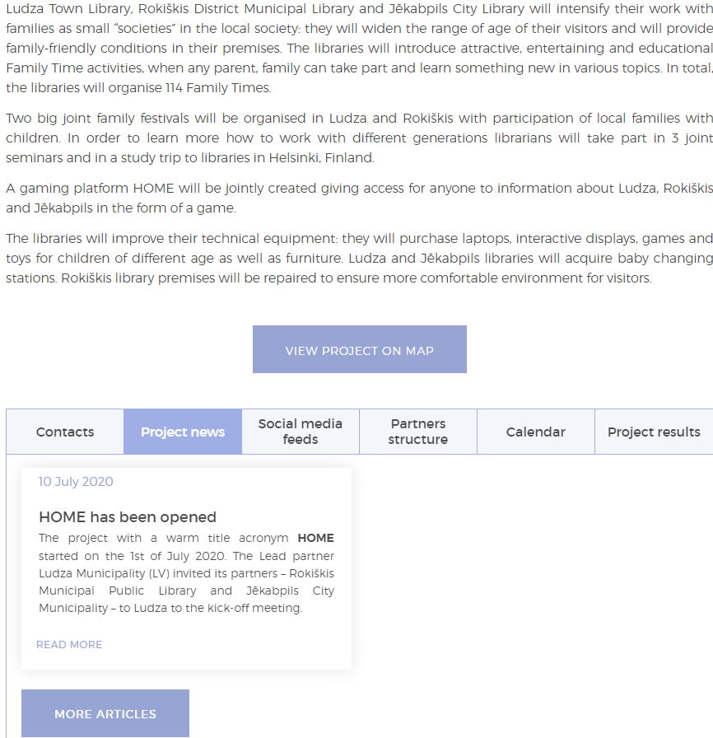
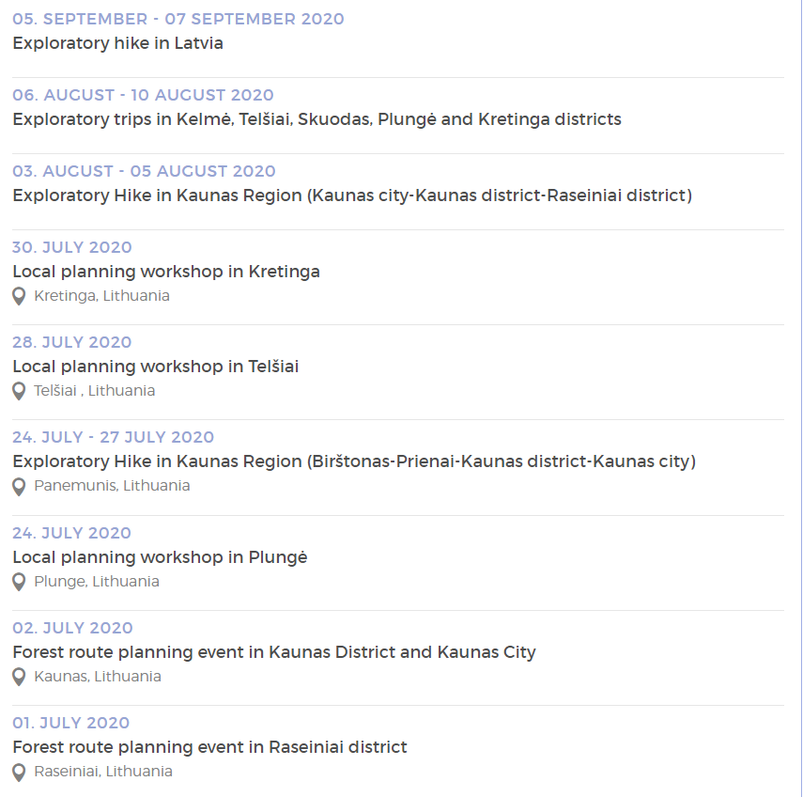
Project section on www.latlit.eu
Should be updated regularly during the project
Active project news section
Active calendar

Slide 7
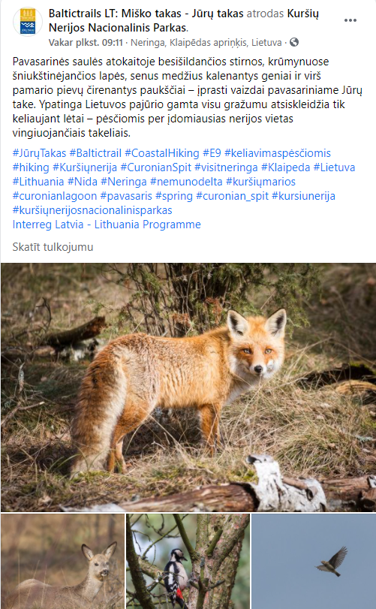
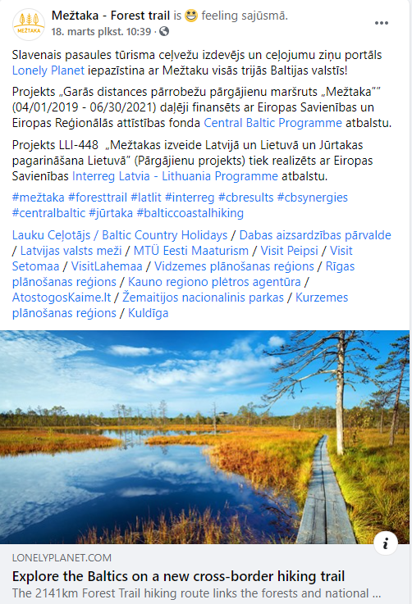
Facebook posts (not paid)
  Use of social media is encouraged
  Tag the Programme @LatviaLithuaniaProgramme (on Facebook)
  Use project acronym

Slide 8
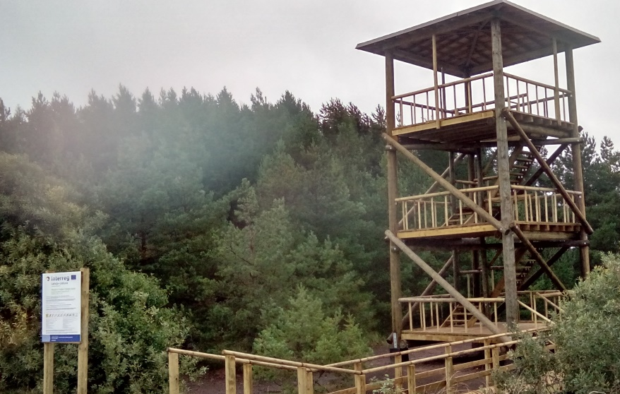
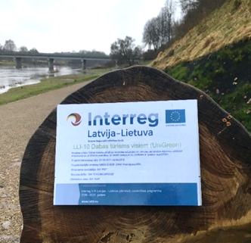
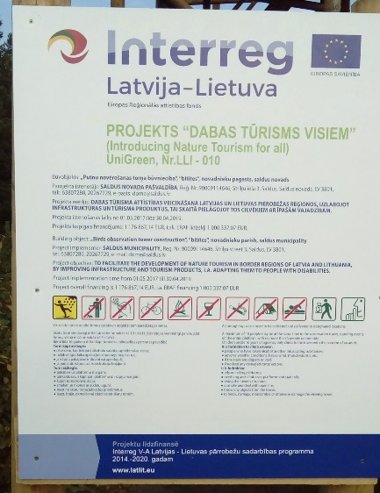
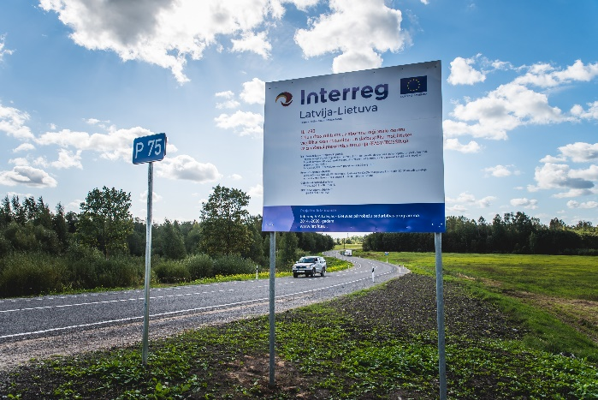
Marking of infrastructure objects
Mandatory for project with infrastructure works:
To put up a permanent plaque or a billboard of significant size.
General information plaques will be provided by JS.
In case in one site the total costs planned for the infrastructure or (re)construction within the project exceed EUR 500 000, to put up a temporary billboard of significant size at the start of works.
  At least 5 years after the finalization of the project.
Communication guidelines:
Mandatory elements
Sample template for plaques

Slide 9
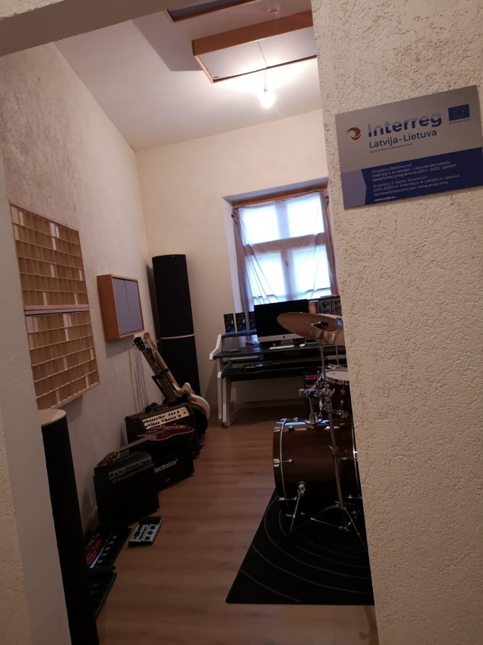
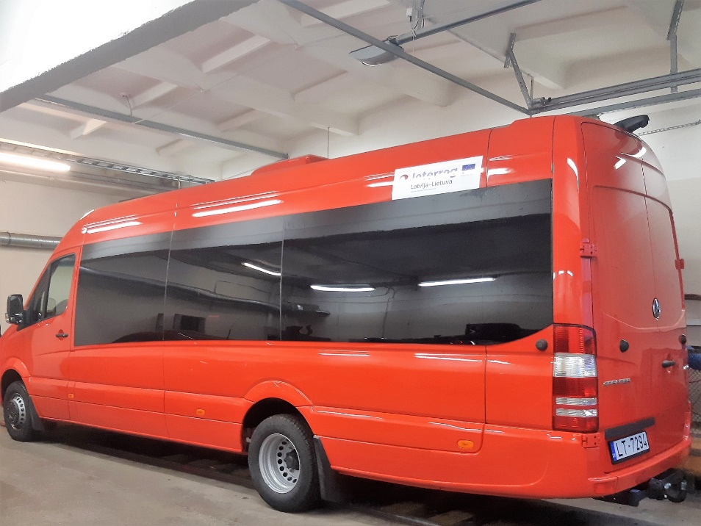
Labelling of equipment
Stickers with the Programme logo &
plaques in equipped premises
  Highly recommended
  After purchase, and after project
Labeling of specialized cars is mandatory
LP should request for stickers and plaques from
Janis.Vanags@varam.gov.lv

Slide 10
Promotional materials
Follow visibility rules
Consult JS if in doubt
Gadgets: lesser, but better

Slide 11

Press release
prepared by the project
recommended to harmonize with JS communication manager
distributed to media
At least
  At the beginning
  At the end of the project
To media in Latvia and Lithuania
To international media is encouraged
Don’t limit to your municipality angle - give sense of larger cross border scope of the project
Recommended
Evidences for the report:
Press release
List of media to which it was sent-out
Copies of publications
Photo by Florian Klauer on Unsplash

Slide 12
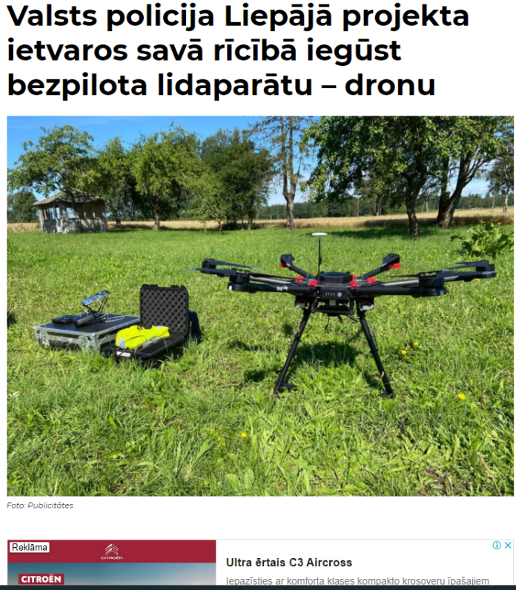
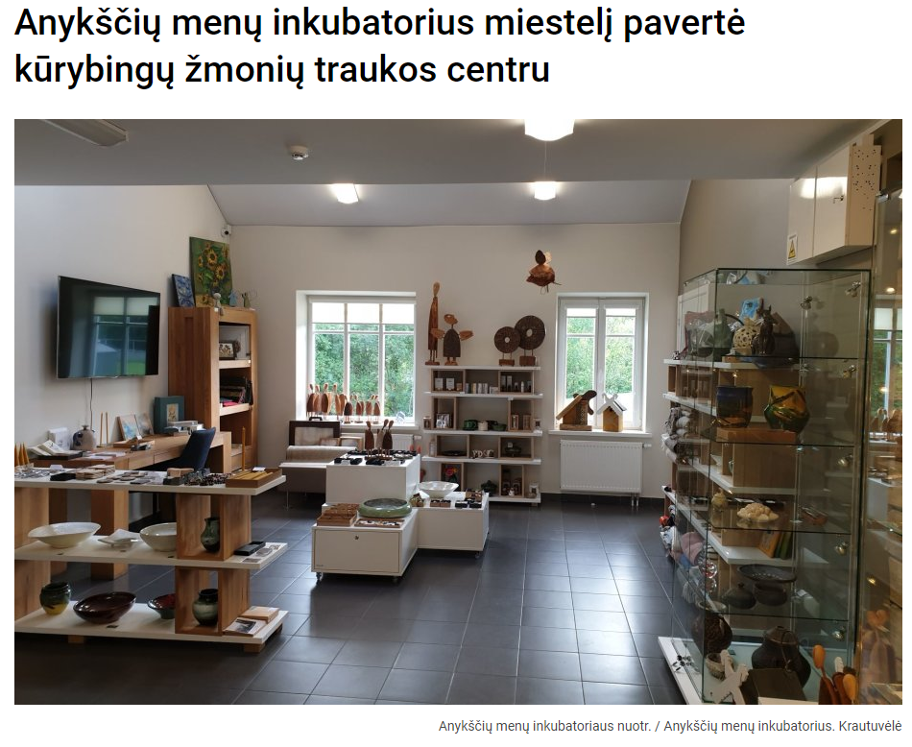
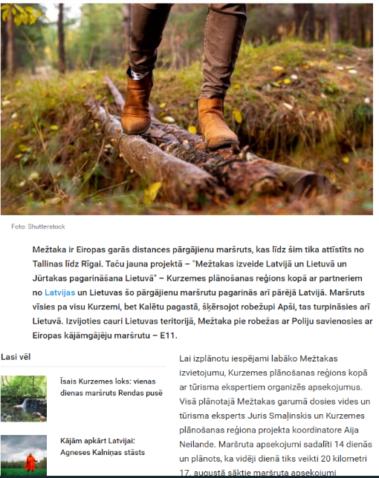
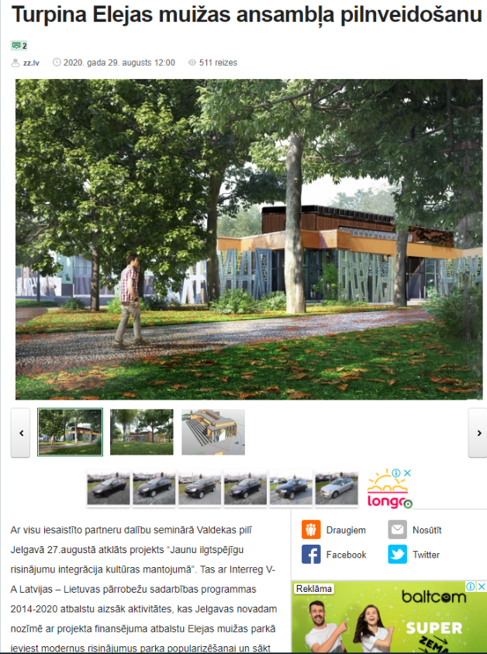
Articles, press releases and other information in media
if reported as deliverable must contain:
Programme logo
Project title
A disclaimer
Information about financial support of the Programme
Address of a website where more information is available

Slide 13
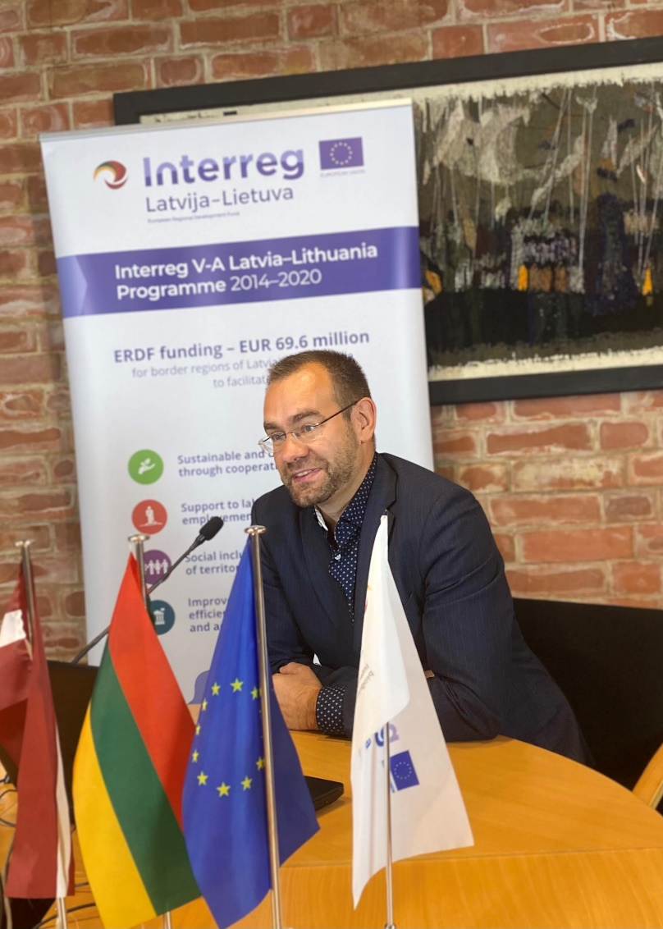
Online events
All event promotional materials and documents (agendas, list of participants, hand-outs, presentations, etc.) must contain:
1) Programme logo
2) Project number, title and acronym.
If possible, please use EU flag/ project roll-up

Slide 14
Common mistakes
Wrong name of the programme, ERDF (check Communication guidelines)
No project number and acronym
Distorted logo of the programme
Size of EU emblem not respected
Amount of ERDF funding is not indicated
Bad language
No disclaimer in case of expressed opinion

Slide 15
Programme logo. Size.
It must be possible to read text in the Programme logo.
Other logos can not be larger than EU emblem.
Shall other logos be bigger than specified, an additional EU emblem should be added.
The recommended minimum withdraw of the programme logo is 60 mm

Slide 16



Incorrect use of logo
Size of logo of other organisations vs. size of EU emblem
Notes:
Es piedāvāju rakstīt šādi: Size of logo of other organisations vs. size of EU emblem.
Es rakstītu ar vārdiem, ka jaliek papildus EU karogs, ja iestādes logo ir lielāks par EU karogu. Vai vismaz ar bultiņām parādīt.

Slide 17


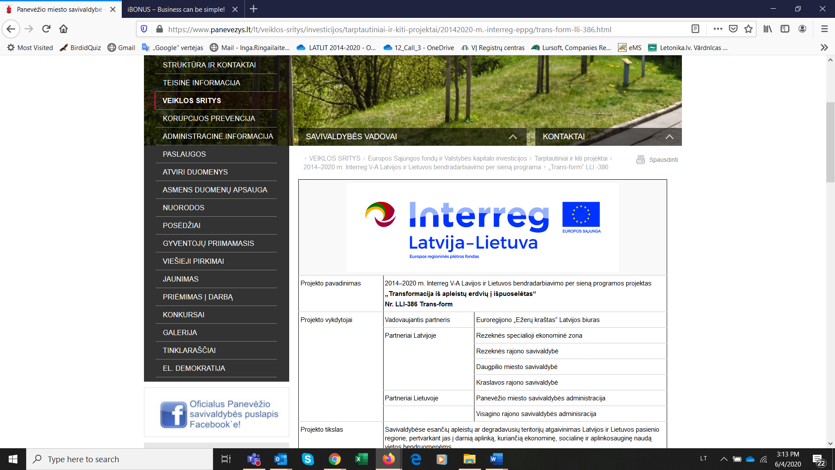


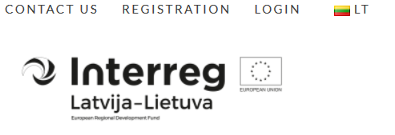



Incorrect use of logo
Distorted logo
Minimised logo when there is enough of space
Distorted colors
Too bright / dark background
Gray / black&white version instead of full-color
Inverted version

Slide 18
Thank you!
Paldies!
Ačiū!
Notes:
Thank you all!

