Slide 1
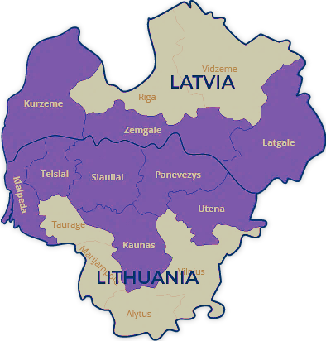
Latvia–Lithuania
Cross- Border Cooperation Programme
2021 – 2027
RESULTS OF ANALYSIS AND SURVEY
January, 2021

Slide 2
MAIN ISSUES INCLUDED IN THE SURVEY
1. Geographical & institutional profile of respondents
4. Already identified & potential project ideas
3. Selection of most important support priorities
2. Identification of main CBC challenges
5. Other suggestions

Slide 3
GEOGRAPHICAL COVERAGE- RESPONDENTS
260
respondents
121 (47%)
139 (53%)

Slide 4
INSTITUTIONAL COVERAGE – RESPONDENTS
49%
11%
10%
10%
6%
5%
4%
3%
1%
1%

Slide 5
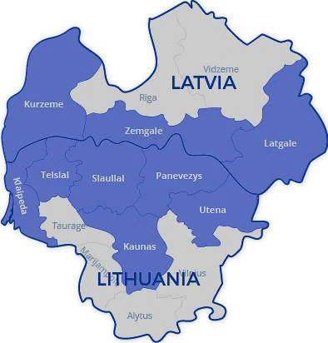
EXPERIENCE IN THE PROGRAMME – RESPONDENTS
Do you have previous experience in this programme?
YES
NO
110 / 42%
LV - LT Programme Region

Slide 6
SUPPORT PRIORITIES – RESPONDENTS’ RANKING
Improving green infrastructure, improving access to nature objects, nature parks and reserves, promoting sustainable tourism on the basis of natural and cultural heritage | 161
Cooperation of public institutions in such areas as security, spatial planning, citizen involvement, e-services, cross-border services, technology transfer, development of a joint tourism offer | 126
Small-scale cross-border cooperation in various fields (social inclusion, education, culture, preservation of traditions, development of crafts, etc.) | 123
Strengthening the role of culture and tourism in economic development, social inclusion and social innovation | 118
Adaptation to climate change, reduction of environmental risks, management of natural disaster risks | 115
Cooperation between business support organizations, entrepreneurs, municipalities and educational institutions to promote employment (especially in social entrepreneurship) | 97
Improving social services and developing integrated services for vulnerable groups, including social, educational and mental health elements | 96
Joint water management | 92
Training to promote employment, skills development in accordance with the needs of the labour market | 89
Strengthening the capacity of public institutions to improve services | 74
Health care services, access to cross-border health services, health promotion and healthy lifestyle | 70

Slide 7
Capacity building and people-to-people cooperation
Green, resilient and sustainable development
Fair and inclusive society
Economic potential of tourism and heritage
ISO/SO 6 Other actions to support better cooperation governance
PO2/SO4: Promoting climate change adaption, risk prevention and disaster resilience
PO4/SO2:
increasing the socioeconomic integration of marginalised communities, migrants and disadvantaged groups, through integrated measures including housing and social services
PO4/SO5:
Enhancing the role of culture and tourism in economic development, social inclusion and social innovation
2
3
4
5
PO2/ SO6 Enhancing nature protection and biodiversity, green infrastructure in particular in the urban environment, and reducing pollution
7
1
PROPOSED PRIORITIES, PO, ISO, SO

Slide 8
Capacity building and people-to-people cooperation
Reskilling and
upskilling
Fair and inclusive society
ISO/SO 1 Enhance the institutional capacity of public authorities, in particular those mandated to manage a specific territory, and of stakeholders
PO4/SO1: enhancing the effectiveness of labour markets and access to quality employment through developing social innovation and infrastructure
PO4/SO4: ensuring equal access to health care through developing infrastructure, including primary care and promoting the transition from institutional to family-and community-based care
ISO/SO 2 Enhance efficient public administration by promoting legal and administrative cooperation and cooperation between citizens and institutions, in particular, with a view to resolving legal and other obstacles in border regions
To reduce risk of duplication and fragmentation of the Programme, it is proposed NOT to include:
ISO/SO 3 Build up mutual trust, in particular by encouraging people-to-people actions

