Slide 1
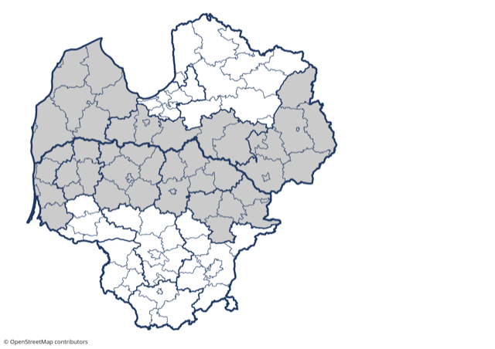
Latvia–Lithuania
Cross- Border Cooperation Programme
2021 – 2027
Public hearing
On-line meeting
10 August, 2021

Slide 2
Feedback from projects of current LATVIA-LITHUANIA CROSS BORDER COOPERATION PRORAMME (2014-2020)
eMS was convenient and user friendly for application and reporting
During COVID-19 pandemic some of activities had to change format
LV & LT municipalities and research institution could collaborate for solving common issues
Great and valuable support to social field and persons with disabilities
An opportunity to implement pollution reduction measures in LV and LT

Slide 3
Preparation of Latvia-Lithuania cross-border cooperation programme 2021-2027
Stategy finalisation
Stakeholder consultations to pre-filter common needs & thematic scope
Survey & Consultations with regional & local stakeholders on priorities
On-line focus group discussion with stakeholders on priorities
Public consultations
Socio-economic analyses & main joint challenges
Draft of Strategy discussed with Programme bodies

Slide 4
Survey of the stakeholders (End of 2020)
Improving green infrastructure, improving access to nature objects, nature parks and reserves, promoting sustainable tourism on the basis of natural and cultural heritage | 161
Cooperation of public institutions in such areas as security, spatial planning, citizen involvement, e-services, cross-border services, technology transfer, development of a joint tourism offer | 126
Small-scale cross-border cooperation in various fields (social inclusion, education, culture, preservation of traditions, development of crafts, etc.) | 123
Strengthening the role of culture and tourism in economic development, social inclusion and social innovation | 118
Adaptation to climate change, reduction of environmental risks, management of natural disaster risks | 115
Cooperation between business support organizations, entrepreneurs, municipalities and educational institutions to promote employment (especially in social entrepreneurship) | 97
Improving social services and developing integrated services for vulnerable groups, including social, educational and mental health elements | 96
Joint water management | 92
Training to promote employment, skills development in accordance with the needs of the labour market | 89
Strengthening the capacity of public institutions to improve services | 74
Health care services, access to cross-border health services, health promotion and healthy lifestyle | 70
RANKING of SUPPORT PRIORITIES
260
respondents
121 (47%)
139 (53%)

Slide 5
On-line Workshop-Discussion “LATVIA-LITHUANIA CROSS BORDER COOPERATION PRORAMME 2021-2027” (May, 2021)
Aim to discuss and exchange views on common & cross-border challenges and solutions
1st priority
Capacity building and people-to-people cooperation
11
As a result, discussed:
9
NGO
Previous knowledge that shall be used for CBC directions in new Programme
More precise focus & scope for CBC challenges for PO2/SO4 & PO2/SO7
Most important challenges & target groups to be approached by CBC under PO4/SO3
Capitalisation of previous results & new CBC challenges of PO4/SO5
12
Government institutions
2nd priority
Green, resilient and sustainable development
6
38 participants
3
Research & education institutions
3rd priority
Fair and inclusive society
10
9
Local authorities
26
12
5
From Programme bodies
4th priority
Economic potential of tourism and heritage
6
Some of participants cover several sectors and Programme prioritities

Slide 6
SELECTED PRIORITIES, PO, SO, ISO
Policy Objectives (PO), Specific Objectives (SO) & INTERREG Specific Objectives (ISO) as the framework defined by EC
1. Capacity building and people-to-people cooperation
2. Green, resilient and sustainable development
3. Fair and inclusive society
4. Economic potential of tourism and heritage
ISO/SO 6 Other actions to support better cooperation governance
PO2/SO4: Promoting climate change adaptation and disaster risk prevention, resilience, taking into account eco-system based approaches
PO4/SO3:
Promoting the socioeconomic inclusion of marginalised communities, low-income households and disadvantaged groups including people with special needs, through integrated actions including housing and social services
PO4/SO5:
Enhancing the role of culture and sustainable tourism in economic development, social inclusion and social innovation
PO2/ SO7 Enhancing protection and preservation of nature, biodiversity and green infrastructure, including in urban areas, and reducing all forms of pollution

Slide 7
Capacity Building and People-to-People cooperation - CHALLENGES
Insufficient involvement of society in decision making
Depopulation of Programme area
(6,6% in LT, and 6.1% in LV)
remote areas have fewer opportunities, less access to public services
Territorial inequalities in terms of welfare, jobs, education, healthcare
Low population density in the
Programme area
New territorial and thematic settings in
LV and LT
new solutions and additional administrative capacity needed
COVID-19 pandemic lockdown

Slide 8
(1) Capacity building and people-to-people cooperation
Indicative activities
Efficient joint solutions and pilot actions for development/ improvement of public services
People-to-people actions and involvement of society in the field of healthy lifestyle, education, cultural heritage promotion
Capacity building, transfer of good practices and development of necessary competences of local and regional authorities
Potential partners
national, regional, local public authorities, public equivalent bodies and NGO’s

Slide 9
Environment and nature protection – CHALLENGES
Nutrient and chemical pollution in water bodies and coastal waters
Loss of biodiversity and decline in the quality of the ecosystem
Lack of common approaches for protecting biodiversity, safeguarding ecosystem services and adapting to climate change
Insufficient awareness among society on pro-environmental behavior
Increased pressure on natural resources and biodiversity due to environmental pollution and climate change

Slide 10
(2) Green, resilient and sustainable development Promoting climate change adaption, risk prevention and disaster resilience
Indicative activities
Joint management solutions of cross-border natural sites promoting climate change adaptation and addressing of disaster risks
Flood protection and other green infrastructure measures (nature-based solutions, flood plains, ecosystem restoration, afforestation, natural water retention measures)
Joint monitoring to enhance the knowledge of climate impacts and facilitate a holistic and systems-based approach
Training, exchange of experience, etc., to support capacity building

Slide 11
(2) Green, resilient and sustainable development Enhancing protection and preservation of nature, biodiversity and green infrastructure, including in urban areas, and reducing all forms of pollution
Indicative activities
Safeguarding, maintaining and restoring of ecosystems and preservation of cross-border biodiversity and key species
Development of joint solutions for enhancing sustainable management of natural capital and cross-border green networks
Joint solutions for reduction of pollution in shared water bodies
Preservation of nature capital that are used for recreational purposes
Training, exchange of experience, etc., to support capacity building

Slide 12
Fair and Inclusive Society - CHALLENGES
Aging society and depopulation of rural areas
Unemploy-ment level above national average
Poverty level above national average
Insufficient capacities for provision of social services
Insufficiently developed social services for marginalized communities in distant & border areas;
Emerging new needs to provide services and support to deprived and affected people due to COVID-19
Ineffective solutions for integration of disadvantaged social groups into the labour market

Slide 13
(3) Fair and Inclusive Society
Indicative activities
Improvement of efficiency and diversification of social services by applying evidence-based measures, new approaches, tools, methods, etc
Development of integrated services, combining social, education and mental health elements, aimed to integration of vulnerable groups
Joint initiatives and awareness raising activities to facilitate development of social entrepreneurship eco- system
Networking, training, exchange of experience, sharing of good practices between the stakeholders involved in provision of social services

Slide 14
Economic potential of tourism and heritage - CHALLENGES
Insufficient quality of tourism offer and infrastructure, sub-opimal use of tourism resources for tourism, health and recreation purposes
COVID-19 crisis has dramatically affected the tourism sector in the Programme area
Sub-optimal use of tangible and intangible heritage for sustainable development of local communities
Lack of efforts to promote the region as joint tourism destination

Slide 15
(4) Economic potential of tourism and heritage
Indicative activities
Joint marketing activities and joint efforts for promotion of the region as an attractive tourism destination
Development of modern, digital and interactive cross-border tourism products (e.g. related to creative industries, crafts, cultural events, gastronomy, etc.)
Access to valuable nature objects, parks and reserves in sustainable way (cycling, educational and walking paths)
Conservation, preservation and development of cultural and historical heritage to strengthen their role in the economic and social development of local communities
Linkage and connectivity of cross-border tourism destinations and offers to international tourism networks
Facilitate recovery of tourism industry from Covid-19

Slide 16
Visioning future Latvia-Lithuania programme (2021-2027)
We will discuss priority by priority -
Common & cross-border challenges and indicative activities
Other general issues
Also, You can write ideas and suggestions in the chat

Slide 17
Thank you!
Let’s utilize the collaboration & co-creation power!
You can have your say about the future of the Programme until 22 August by e-mail: latlit@varam.gov.lv

